Slide 2
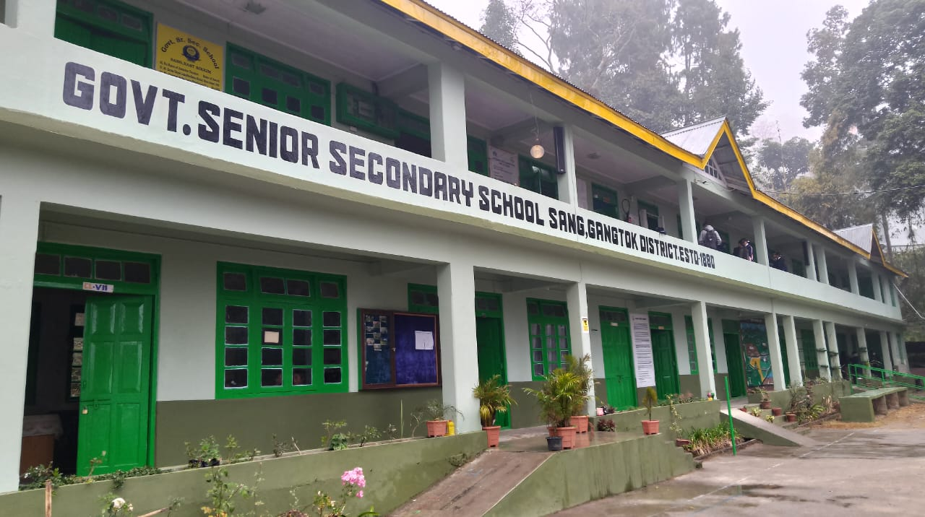
INCENSE
ANNUAL SCHOOL MAGAZINE
SANG SR. SECONDARY SCHOOL, EAST SIKKIM

Slide 3
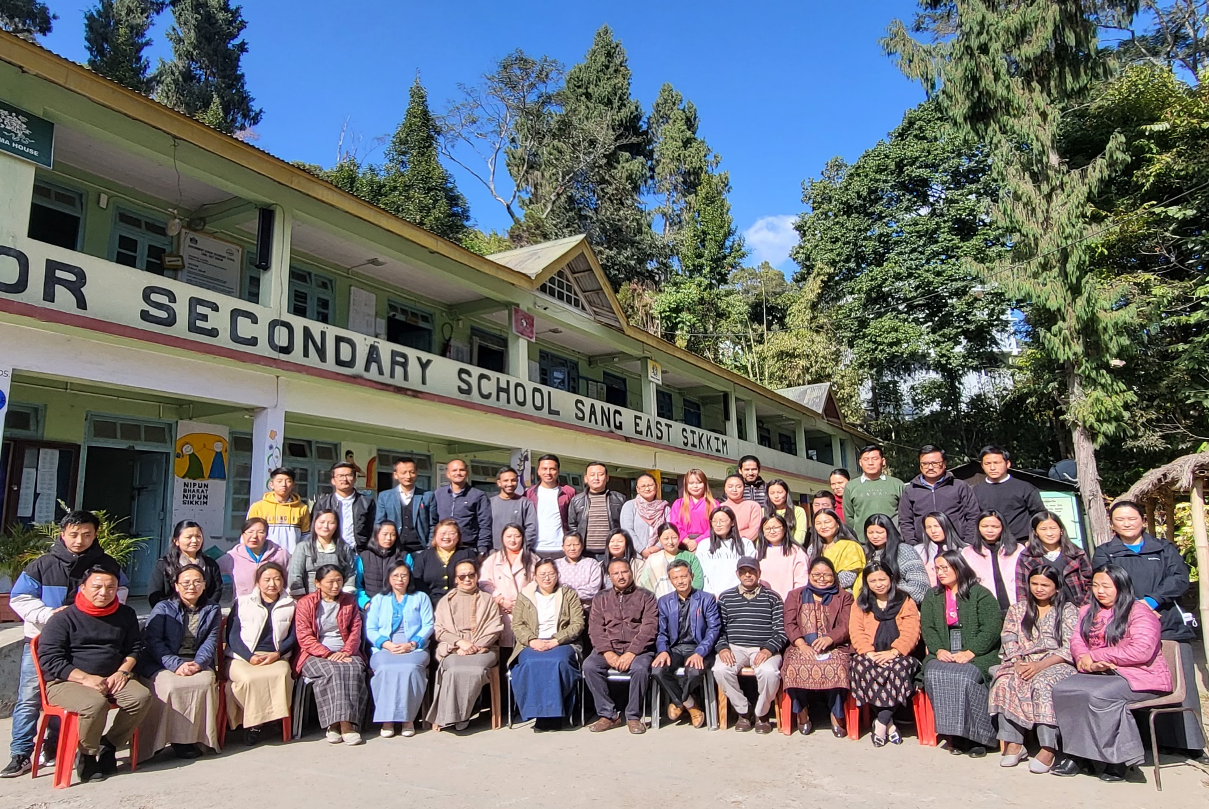
OUR SCHOOL FAMILY

Slide 4
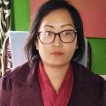
MESSAGE FROM PRINCIPAL DESK
I am really excited to pen down from this desk on the publication of our
Annual School E- Magazine “INCENSE” 2023.
Since as a Principal, its my first opportunity to note down some messages to our school. Its really a matter of pride and honour to lead the family of Sang Sr Sec School.
As coming to the new era of Globalization, stepping towards New Education Policy- 2020. The school has launched its first INCENSE E-magazine and its really the best way to make use of Technology.
Sang Sr Sec School really focus towards fostering young minds, developing creativity and creating a healthy learning Environment, for which I am very proud and happy with all our team who are dedicated towards their duties and responsibilities and are also very supportive among each other.
The school e magazine is a multifaceted platform which gives an equal opportunity to all the stake holders of Education to express their writing skills, developing creativity and accumulating all the Activities, Achievements which the school have achieved during this session.
I am really happy with all the team for entire environment in present scenario and I hope it will continue in the same manner and spirit.
I express my hearty congratulations to our School Magazine Team for exploring and sharing your ideas and coming forward for this E-magazine.
My best wishes to all the family of Sang Sr Sec School and I hope the coming session will be more beneficial and fruitful to all the Staff and students.
With Regards

Slide 5
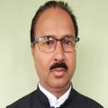
Message From Vice Principal
It is a proud moment for me to address you through this magazine. It is evident that this school have been striving to maintain high academic standard ever since its foundation. For this purpose, we have been providing you with a wide varieties of opportunities in scholastic and co-scholastic areas where you can develop your talent and fulfil your dream. In this regard, this Digital school magazine “INSENCE” will be of great help in developing your writing skill and quest for knowledge. Now it is upon you to take the full advantages of opportunities. Hence I exhort you to gain knowledge and fit yourself in the challenging world.
Lastly I would like to extend my warm wishes to the editorial board and columnists of this magazine who did a remarkable job.
With Regards
R.K Thakur
Vice Principal

Slide 6
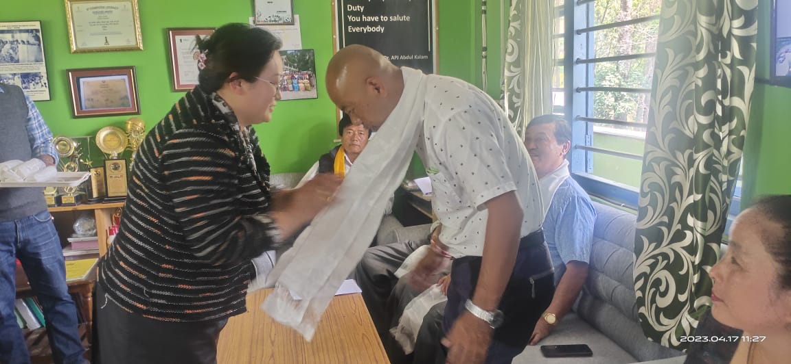
SMDC /SMC Members
Ex Officio- Mrs Tshering Doma Bhutia Principal)
Chair Person-Mr Ugen Tenzing Bhutia(Panchayat Kagyu Gumpa)
Mr Nima Lhendup Bhutia ( Panchayat V-President, Zingla Masha)
Mrs Phigu Bhutia , PGT (Hindi)
Mr Sonam Tashi Bhutia, GT(Arts)
Mr Dupchen Shenga (PRT)
Mr KD Bhutia ( Ex Principal Director, Mines & Geology)
Mr Wangchuk Namgyal Bhutia, (CRC,Sang)
Mr, KB Tamang ( Retired Teacher)
Mr Phurba Dorjee Tamang , Rabdang
Mr Sonam Wangdi Bhutia, Beyong
Mrs Karma Doma Bhutia, Sang Bazar
Mr Tashi Thendup Bhutia, Ex Panchayat
Mr Yadhu PD Poudyal,
Mr Nirmal Century,
Mrs Sabina Chettri, Parents

Slide 7
INAUGRATION OF CHILDREN PARK-2023

Slide 8
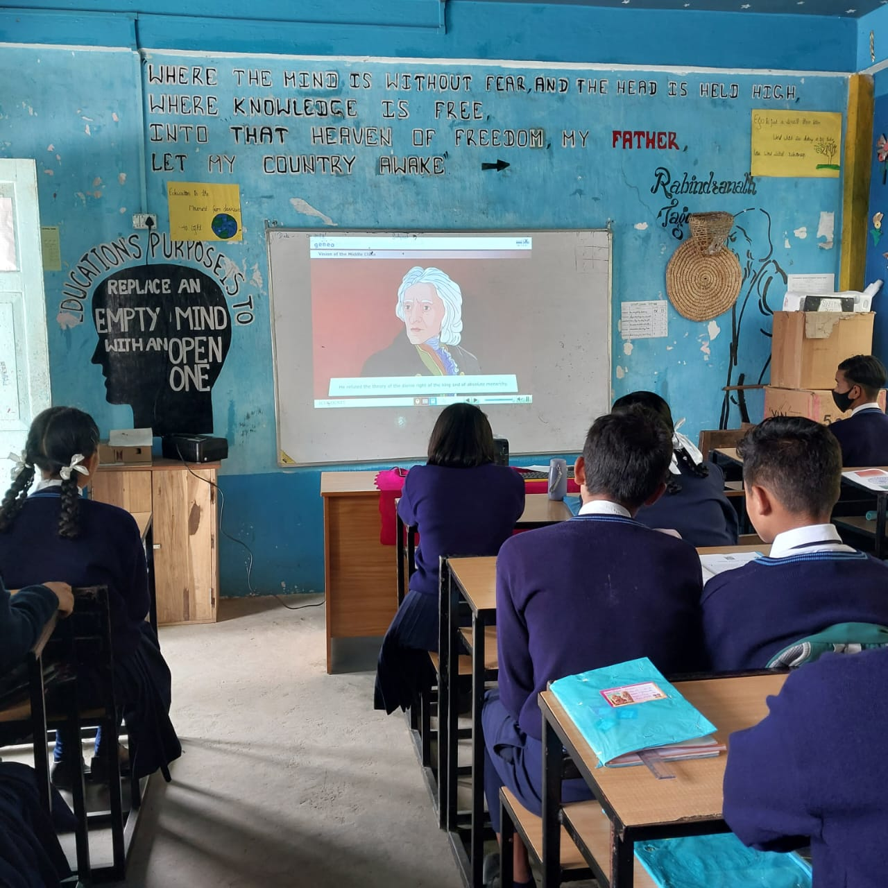
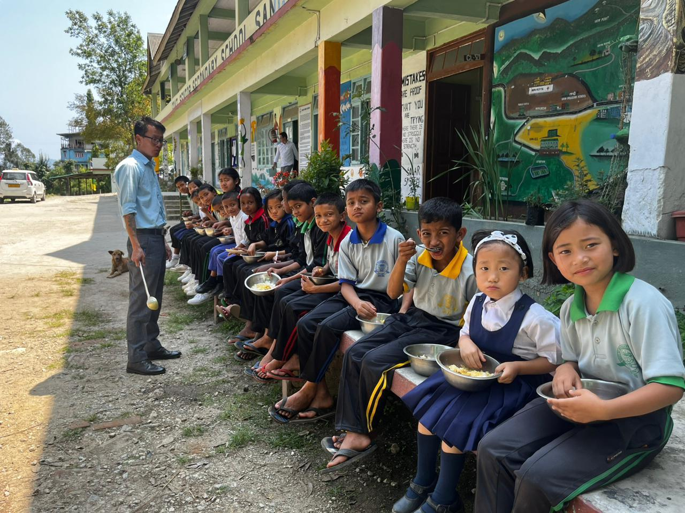
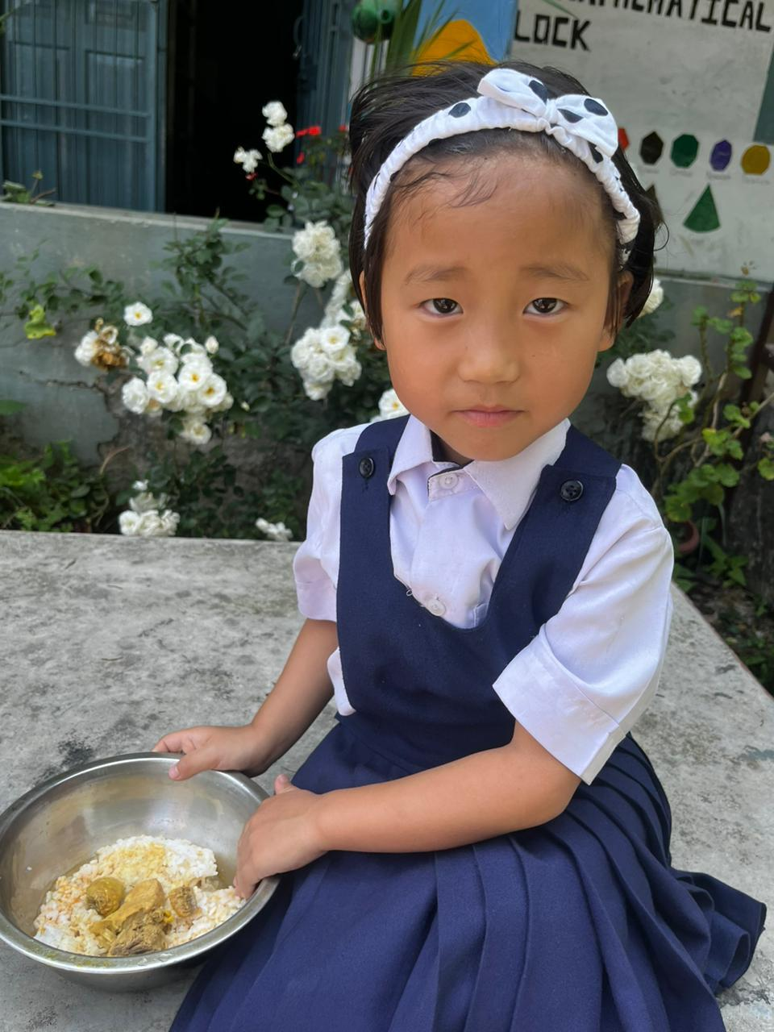
SCHOOL ANNUAL REPORT 2023 :-
Sang Senior Secondary School is one of the oldest institution in East Sikkim established in 1880. It is a Co-ed school affiliated to Central Board of Secondary Education (CBSE).The school has always remained steadfast in creating strong foundation, good health and hygiene practices for children from pre-primary to secondary. To improve the nutritional status, enrollment and retention rates, the school serves fresh hot cooked mid-day meal for them.

Slide 9
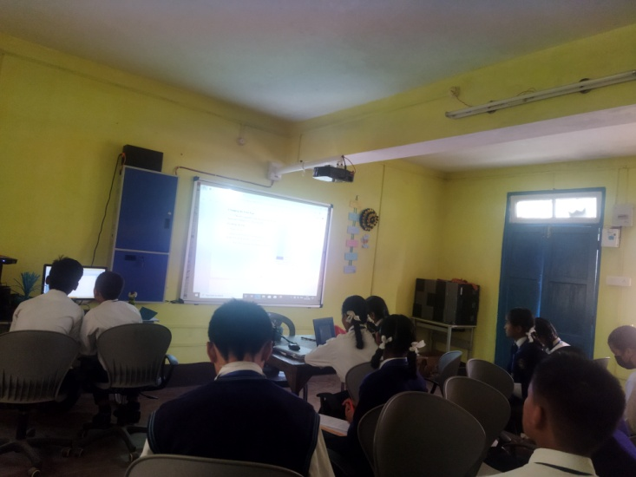
Within the school building there is a library room, computer classroom, science laboratory, reading corners in primary section, mini amusement park for primary students and about 15 classrooms. The school has a spacious auditorium with a seating capacity of 200 students. Witness to special assemblies, annual days, prize distribution ceremonies, show and tell competitions, farewells and more, it is an indispensible part of the school where the students learn many useful life skills as confidence, team spirit etc.

Slide 10
Sang School has about teachers including Principal and about …. Non- teaching staff. There are about …boys and ….girls altogether with ….enrolments. The school also provides safe and adequate drinking water facilities to all children with an emphasis on hand washing etiquette and separate toilets for boys and girls.
Sanitary Napkin Machines and incinerator has also been installed with smoke control units in toilet for girls.
The medium of teaching is English. The streams at higher classes are Bioscience, Commerce and Humanities. There are optional vocational streams like Travel and Tourism Management and Food Production. Govt. provides free education from primary till class VIII with free books, school bags, raincoats, school dresses and lunch during recess.
With the introduction of the three language policy under the National Education Policy 2020 as of now the School provides Bhutia, Nepali, Lepcha and Limbu as options for the second language.
As per the guidelines issued by MHRD and board, the school has installed CCTV within the premises to ensure complete safety and security of students.
Parent Teacher meet are also organized twice a year to check the academic progress of children.

Slide 11
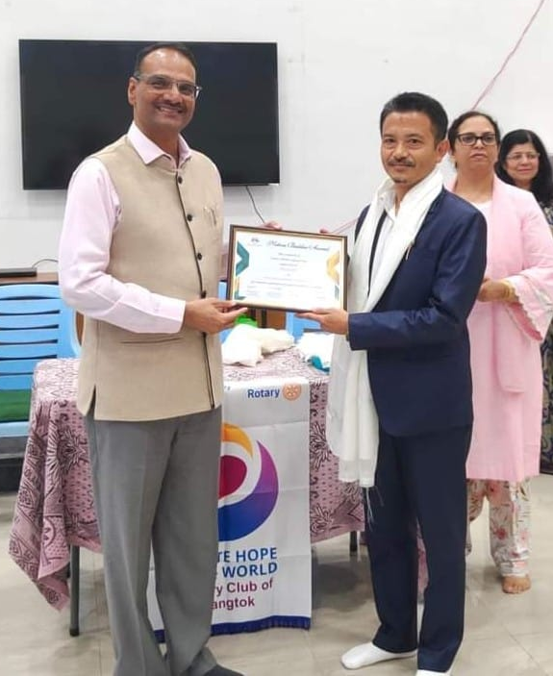
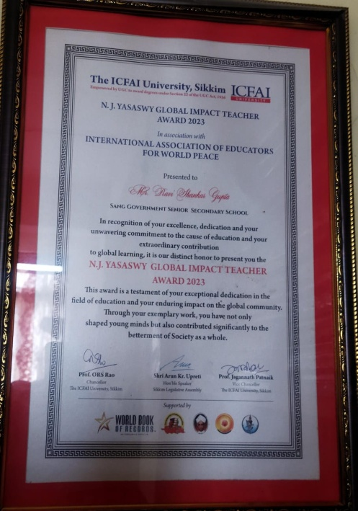
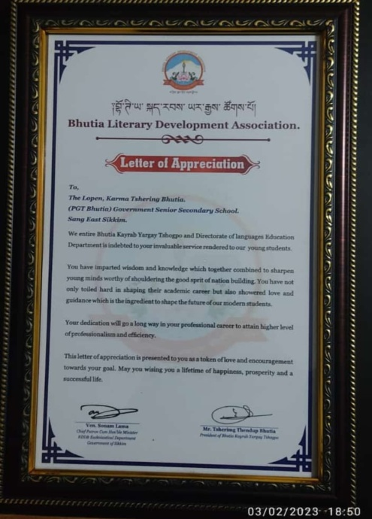
ACHIEVEMENTS BY TEACHERS
R S GUPTA
Maths Teacher - 2023
DINESH RAI
NATION BUILDER AWARD -2023
KARMA TSHERING BHUTIA
BHUTIATeacher - 2023

Slide 12
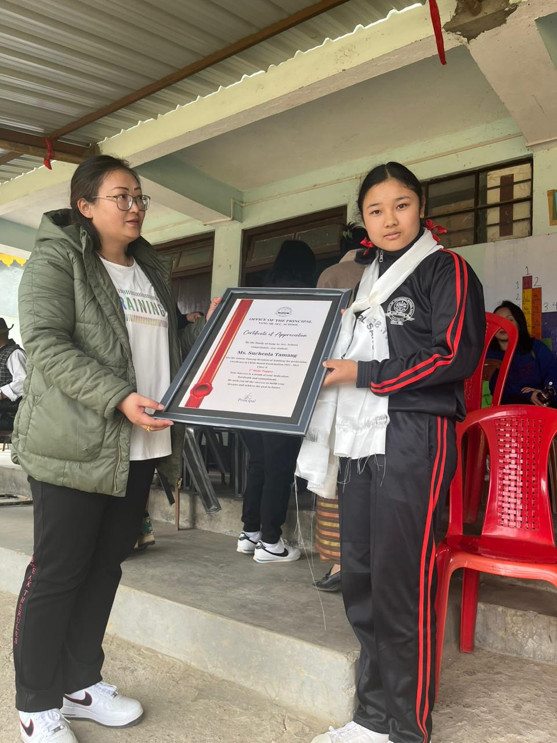
Academics Excellence:
The captain’s investiture ceremony was held on ……March administered by the school Principal Mrs. Tshering Doma Bhutia where the institution formally appointed the newly elected prefects for the year 2023.To add the spirit of competitiveness the school has divided the students into four houses viz- Red, Blue, Yellow and Green.
Success is dependent on effort and success is the sum of small efforts. Yet another academic year of success and achievement unfolded with an honour conferred on CBSE students with 100% batch pass percentage in the year 2023. The unstinted support and dedication of the teachers was evident in the success of our students in board examination - CBSE.
Miss Suchenla Tamang emerged as the 3rd State topper with
86.6 % in AISSE -2023 Examination
AISSCE -2023
1. Miss Suk Maya Rai 87.8% (Hum)
2. Pooja Bahun Sharma: 81.8% (Hum)
3. Nikita Kumari: 86.4% (Sci)
4. Dawa Yangzom: 83 %( Sci)

Slide 13
The school also focuses on other chief aspects of integrated education as honing the skills of the student and enabling them to think and reason for themselves. Hence in addition to the use of smart board classroom teaching, a host of activities are conducted at the school to impart quality exposure to the students. Every year we conduct a host of inter – class and inter – house co –curricular activities such as elocution, quizzes, dance, song, calligraphy, painting and drawing, slogan writing, debates, extempore, recitation, essay writing, creative writing, drawing, spell bee and story narration at both junior and senior levels.

Slide 14
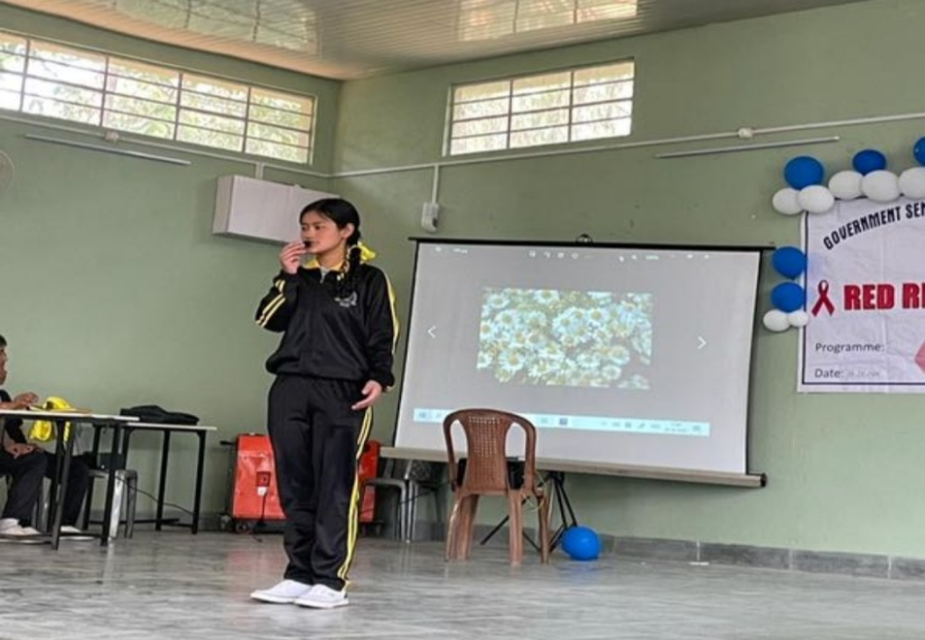
CELEBRATION OF NATIONAL AND INTERNATIONAL DAYS
NATIONAL SCIENCE DAY, 28TH Feb 2023: National Science Day was celebrated by the students in school. The theme of the year 2023 was Global Science for Global Wellbeing.
Hindi Diwas, 14th Sept: An assembly and a host of activities like Poetry recitation quiz and spell bee was conducted in school to mark the importance of the day.

Slide 15
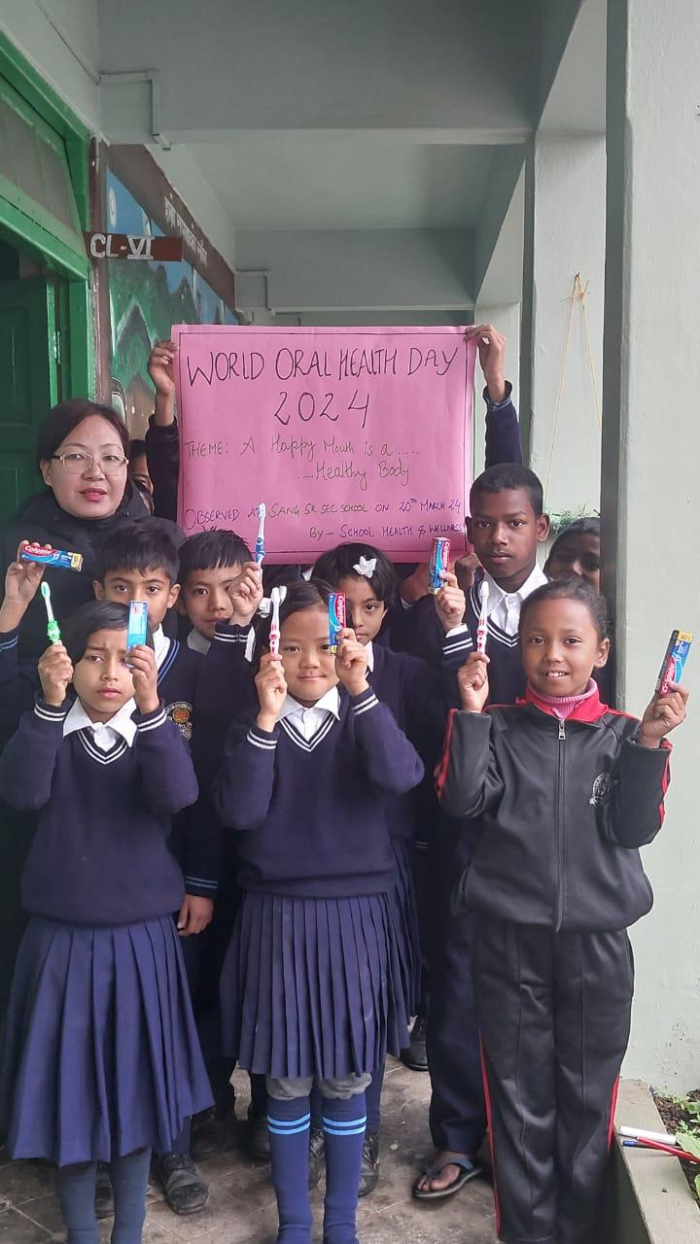
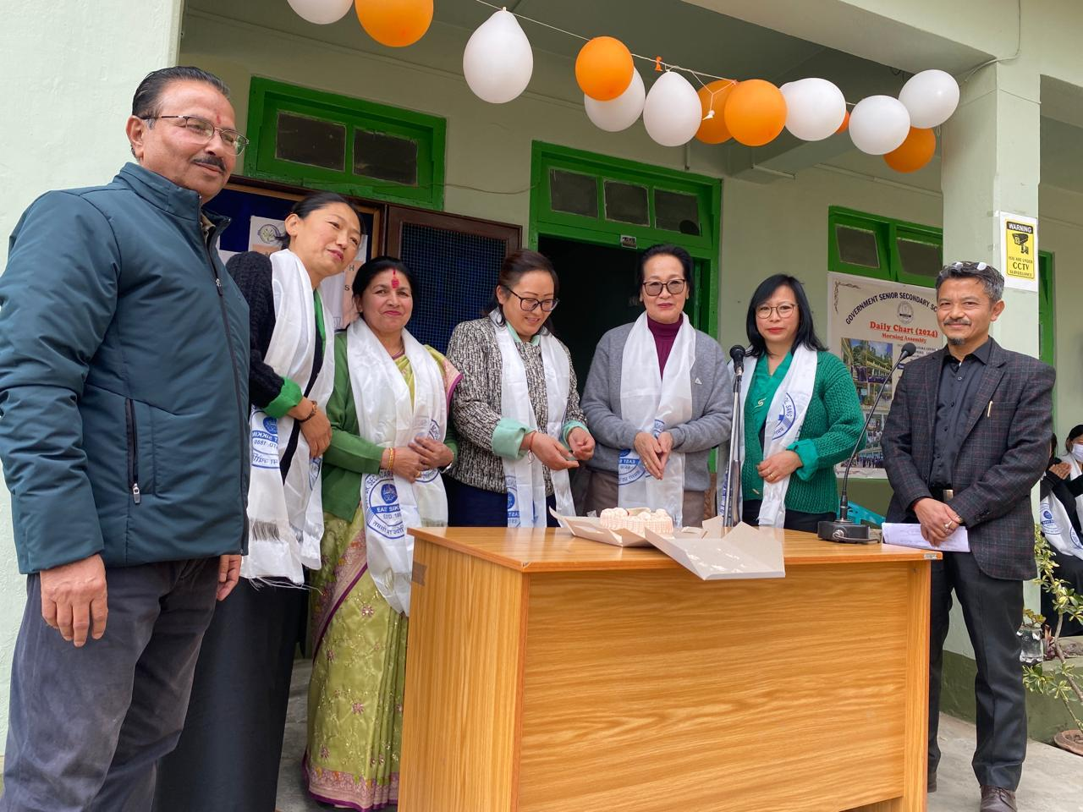
WORLD ORAL HEALTH DAY, 20TH March2023
With the theme “Be Proud of Your Mouth” the members of Health and Hygiene Club of Sang School displayed the children’s poster and empowered the children about the importance of a healthy mouth and encouraged the practice of regular brushing at least two times a day.
INTERNATIONAL WOMEN’S DAY
8th March 2023 : International women’s day was celebrated in school as a mark of respect towards lady staff members. The significance of the day taught our students the world needs to be free of bias, stereotypes and discrimination and where women are valued and equality is celebrated.

Slide 16
WORLD WATER DAY; 22ND March 2023: World Water Day celebration with the theme “Accelerating Change” was celebrated in school to raise awareness about the value of fresh water and a call for the wise use of freshwater resources. The students actively participated in painting and slogan writing competition.
Ambedkar Jayanti, 14th April: To commemorate the teachings and contribution of Dr. B.R. Ambedkar towards the upliftment of society, activities like role play for the junior sections and group discussion for the senior section was organized to inculcate the values in life.

Slide 17
Earth Day, 22nd April: Activities were organized with the aim to raise awareness amongst students about climate change, global warming and conserving mother earth.
Road safety week 20th May: To inculcate the students about awareness on road safety Police officials from Sang Outpost visited the school and interacted with the students about the Do’s and Don’ts. Students were involved in poster making and slogan writing.

Slide 18
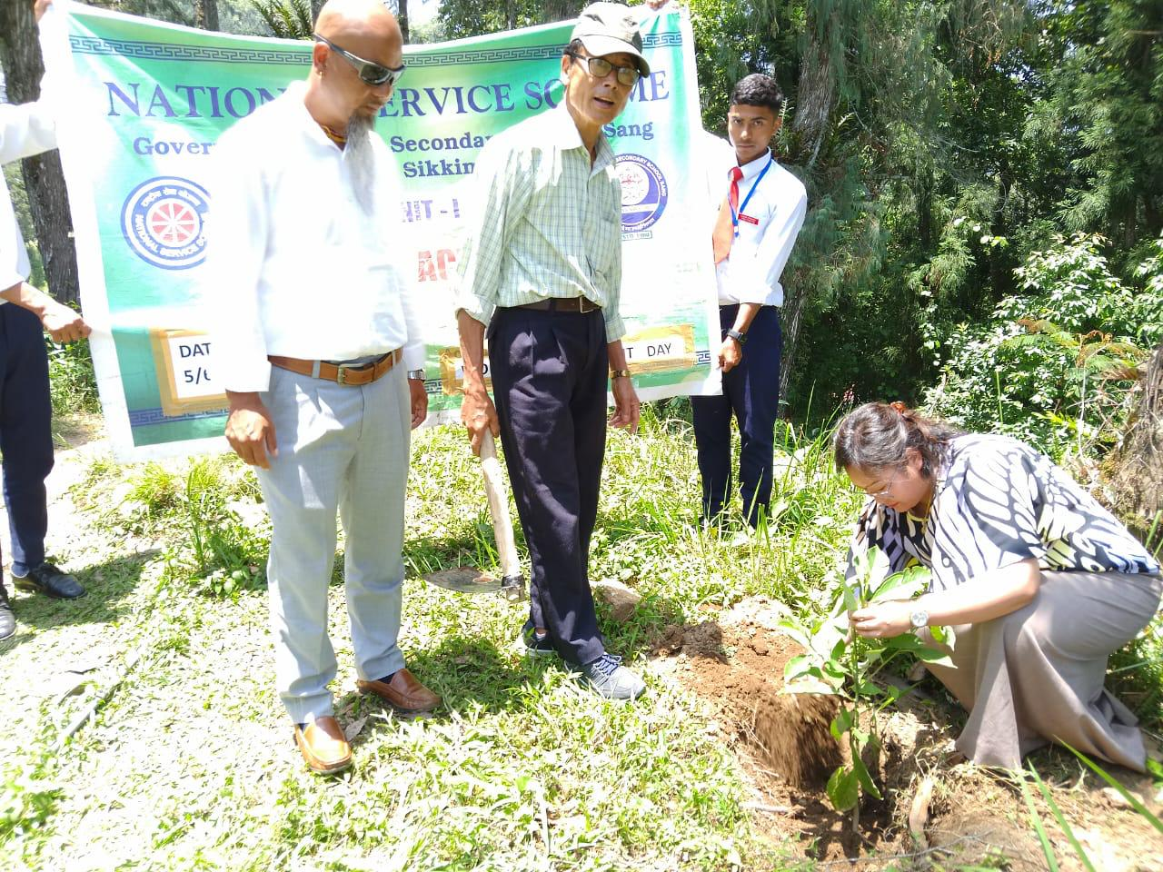
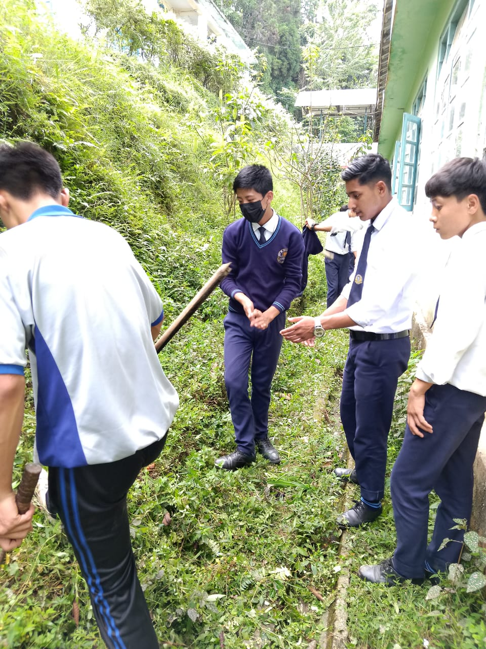
World Environment Day 5th June is celebrated in school to encourage the students to plant trees and spread action for the protection of the environment.

Slide 19
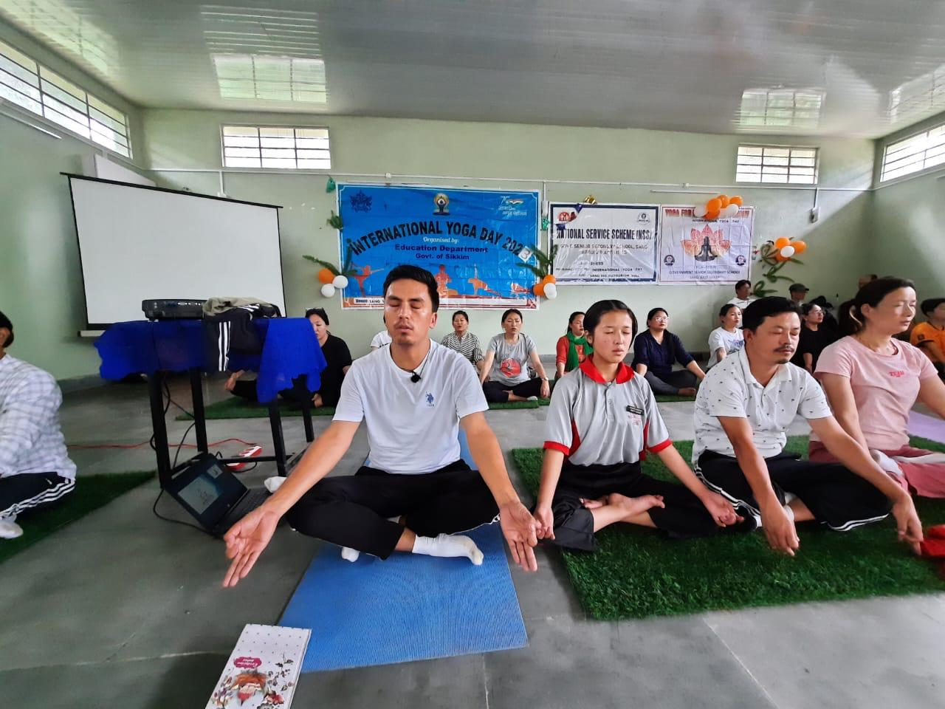
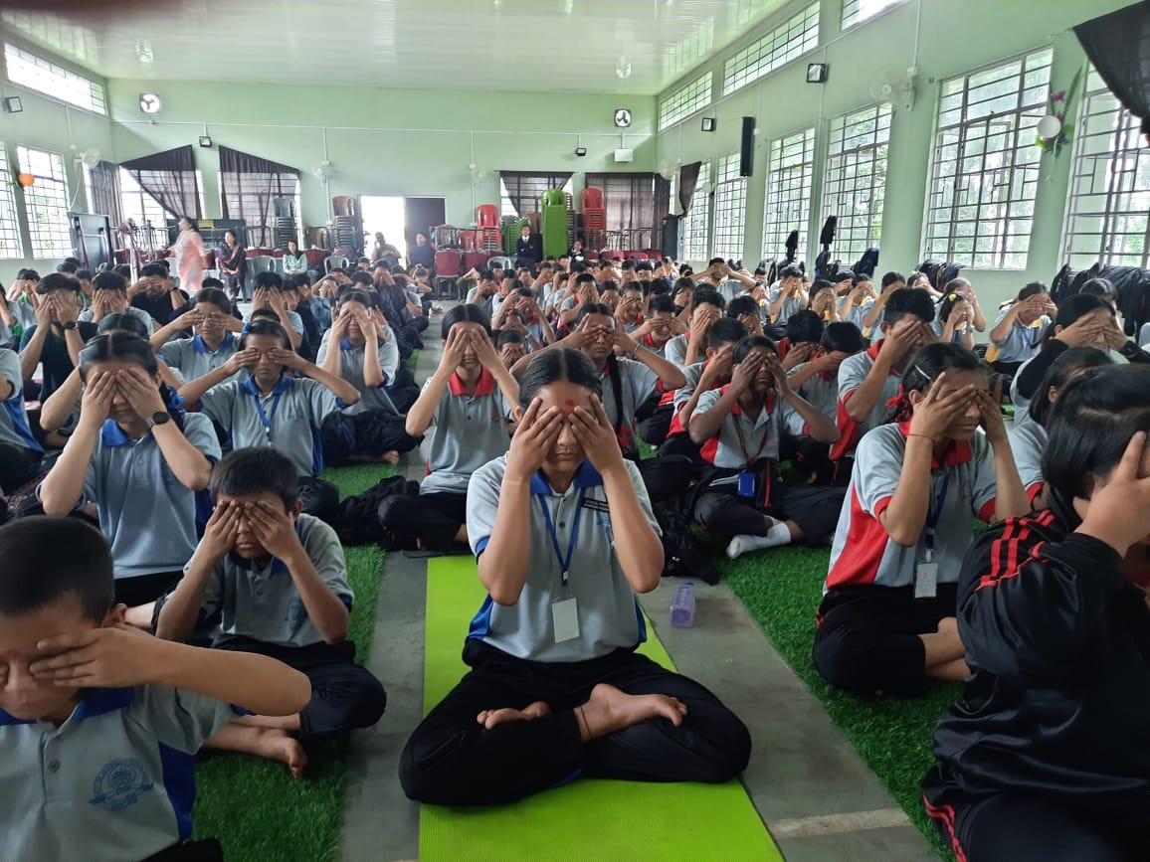
International Day of Yoga 21st June is celebrated every year in Sang school with great enthusiasm.

Slide 20
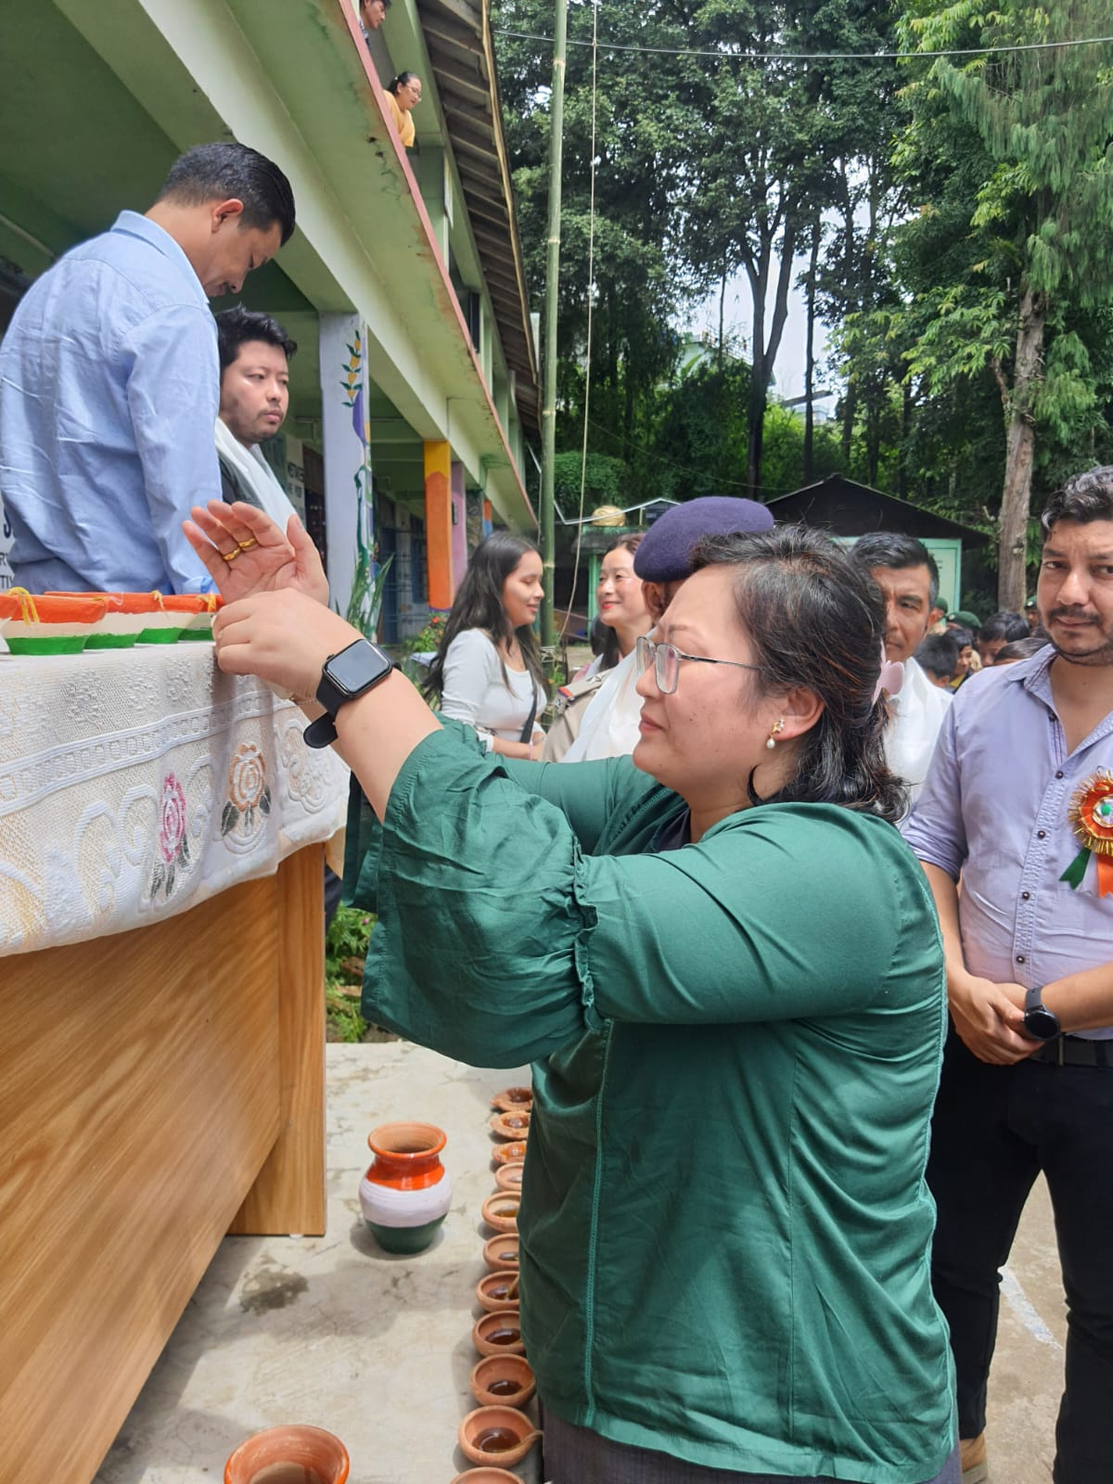
MERI MAATI MERA DESH

Slide 21
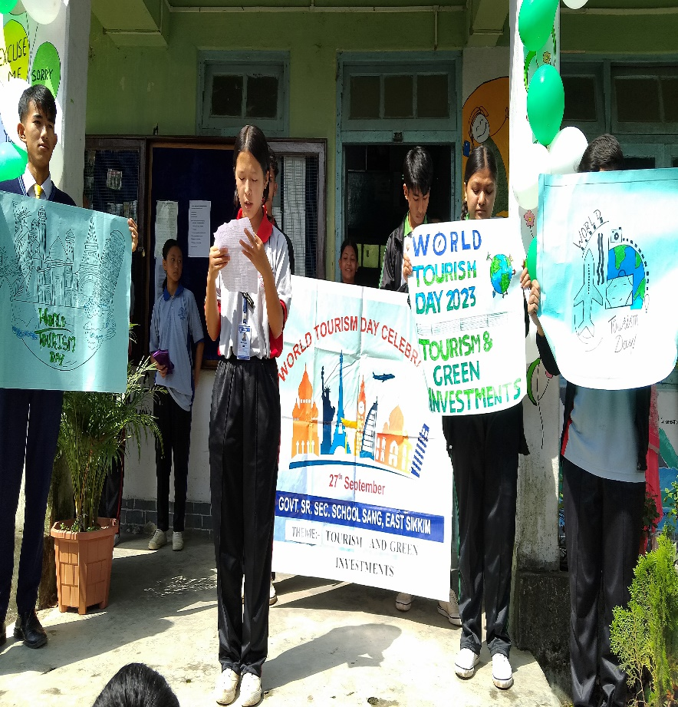
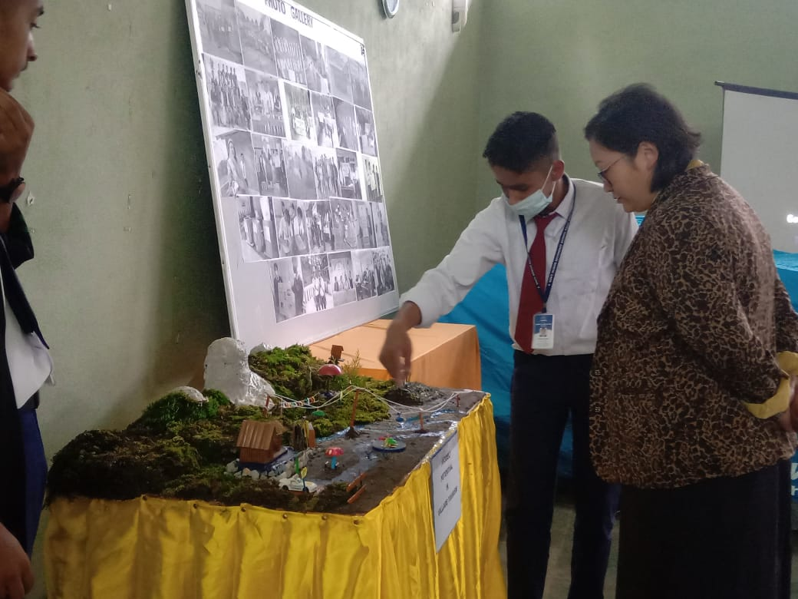
World Tourism Day
27th September World Tourism Day is celebrated in the school on theme “Tourism and Green Investment”

Slide 22
76th Independence day was celebrated with great honour and patriotism with Zilla Panchayat hoisting the flag.
On September 5th, the teachers day was featured with students organizing cultural events. All the teachers were felicitated by the students and were presented with tokens of love and gratitude.
Hindi Divas, 14th Sept: An assembly and a host of activities like Poetry recitation quiz and spell bee was conducted in school to mark the importance of the day.

Slide 23
World Mental Health Day 10th Oct: Activities were organized to promote the global mental health awareness and advocacy against social stigma in our society.
INTERNATIONAL LITERACY DAY 11th Nov: To mark the birth anniversary of Maulana Abul Kalam Azad , sessions were organized for the students about the history and significance of the day to make children aware about the same. An interschool activity was conducted to spread awareness about the importance of this date and its application in the present times.
RASHTRIYA EKTA DIVAS Activities 31st Oct: E-pledge, Poster making, Slogan writing activities were conducted.

Slide 24
CBSE ACTIVITIES
Swachchata Pakhwada was organized in school. Activities like personal hygiene day, hand wash day, green school drive, swachhata shapath were organized.
Reading campaign was also organized for the classes from primary to middle. Reading is the foundation of learning which motivated the students to read books independently, develop creativity, critical thinking, vocabulary and the ability to express both verbally and in writing. It helped the students to relate to their surroundings and real life situations.

Slide 25
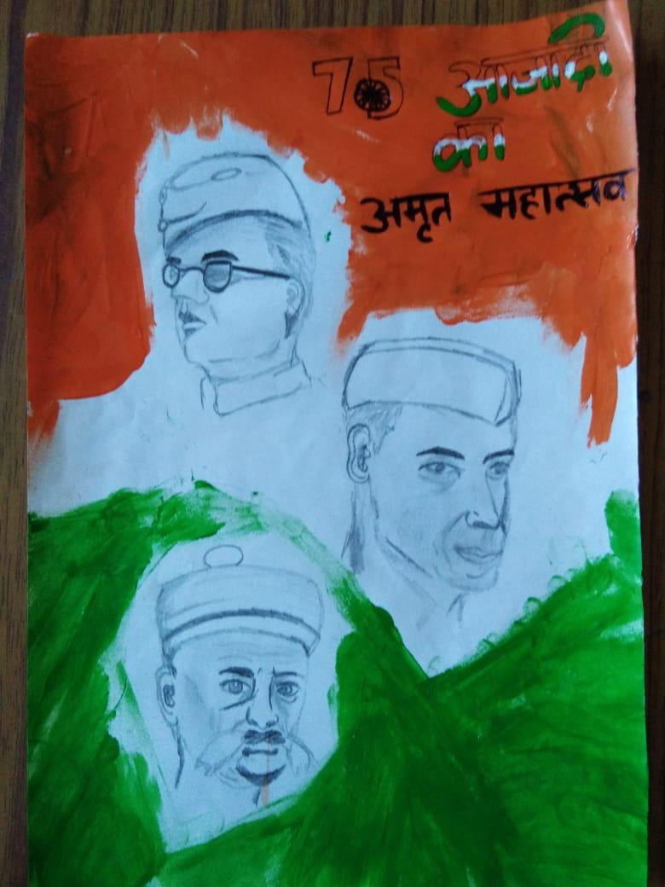
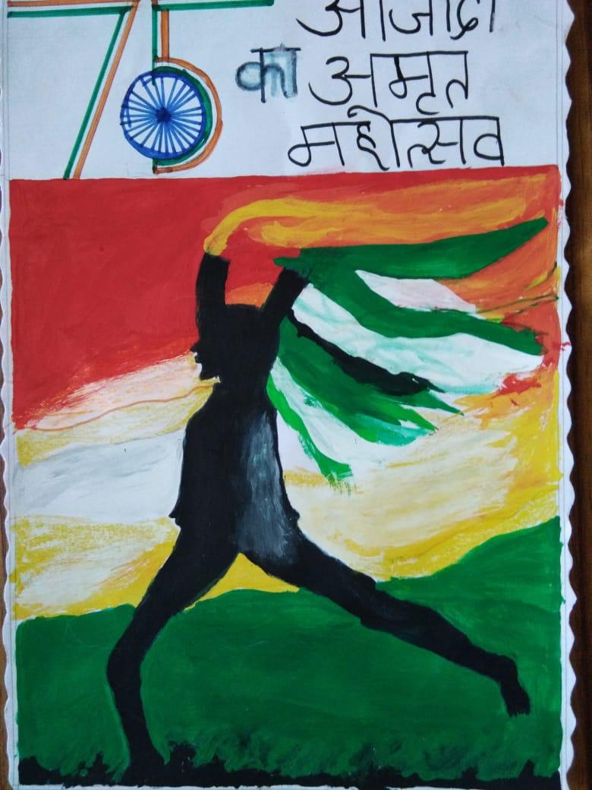
EK BHARAT SHRESTHA BHARAT activities were conducted with paired state – Delhi from October to February. Activities like Alphabet writing, song, proverbs, unique words, project o tradition and culture, pledge on swachhata, single use plastic, water saving, talk shows were organized by teachers and students.
An illustrated document on NEP was prepared by the Principal for teachers and students.

Slide 26
SCHOOL CLUBS
Club activities help students develop sense of unity and teamwork. Sang School encourage students to participate in various activities and widen their horizon for their all round development. The school has following clubs:
SPORTS CLUB: At Sang SSS we lay a strong emphasis on sports and physical development. Football is the most popular sport and every boys and girls actively participate for the competition. Cricket, Volleyball, Table Tennis, badminton, throw ball are other important games played on regular basis.

Slide 27
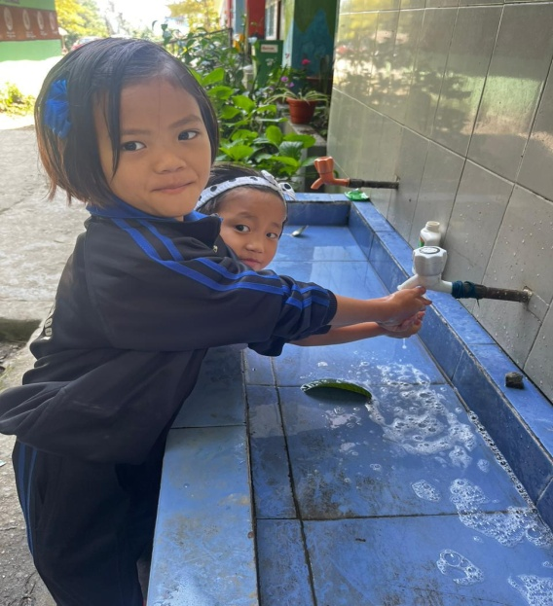
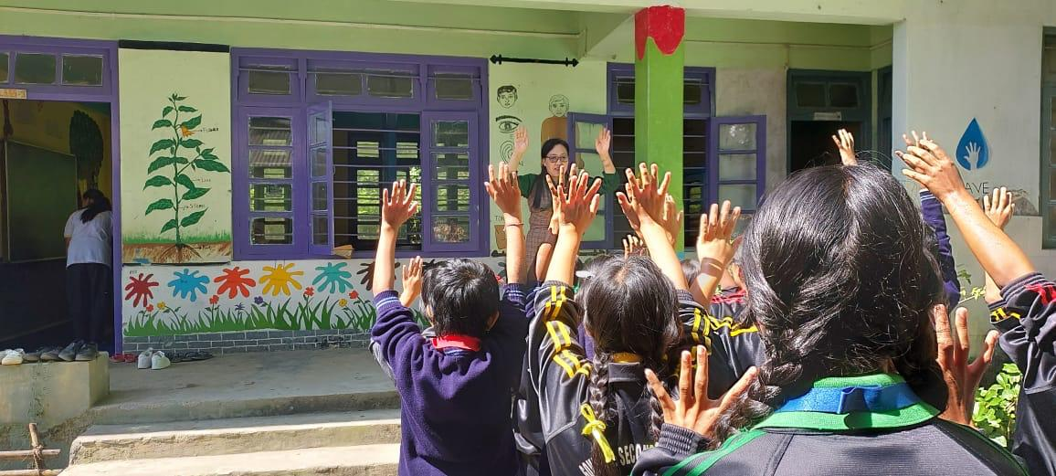
HEALTH AND HYGIENE CLUB
The aim of this club is to foster good habits for hygiene, healthy food and personal health awareness. The club provides an avenue for self awareness beyond the school curriculum. The club motivates the students to develop healthy food habits, good health and personal hygiene by teaching students about washing the body often, cleaning the teeth at least once a day, washing hands with soap after going to the toilet. Iron and Folic Acid and De worming tablets are distributed to students from classes 6th – 12th. The activities undertaken in Sang School are Lectures are given on Health and hygiene in the morning assembly for students, World Oral Day, World Health Day, International Yoga Day is observed.

Slide 28
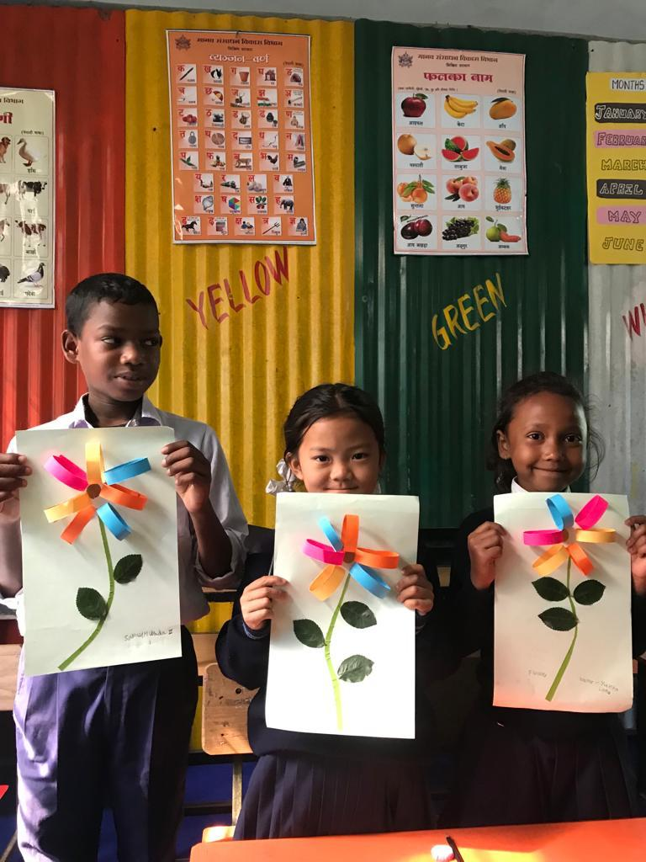
RED RIBBON CLUB
RRC members of Sang SSS promote access to information on the control and prevention of HIV &AIDS. The activity organized by the school includes awareness campaigns like rallies and outreach activities like donating blood to all the needy.
COLOR STROKE
Sang SSS has formed a ‘Color Stroke’ group with a purpose to give young children every opportunity to gain self confidence, creative thinking and a sense of self worth that will help in the positive development of their personality.

Slide 29
CHESS CLUB
To motivate the students to improve academic skills such as concentration, reasoning, creativity and problem solving Sang SSS has initiated Chess Club from last year.

Slide 30
NCC : UNITY AND DISCIPLINE
Mr. Rudra Prasad Sharma
PGT ( Phy )
ANO
1st & 3rd Sikkim Battalion boys / girls
Sang SSS has welcomed this initiative in the year 2019 which offers training to the student. The students inculcate a sense of team work, leadership skills, secular outlook, and spirit of adventure, sportsmanship, self discipline and ideals of selfless service at an early age. The cadets are given basic military training in small arms and parades.
There are 2 units of NCC in Sang Senior Secondary School viz
1st Sikkim Girls Battalion, which consist of girl students only.
3rd Sikkim Battalion which consist of boy students only.
The primary activities that the NCC cadets of our school perform are awareness programme on cleanliness drive and plantation drive. Every Saturday NCC classes are conducted where the students learn about map reading, FC/BC, Armour force and NCC weapons. The students actively perform drill on Republic, Independence and NCC day to pay respect to our Mother India.

Slide 31
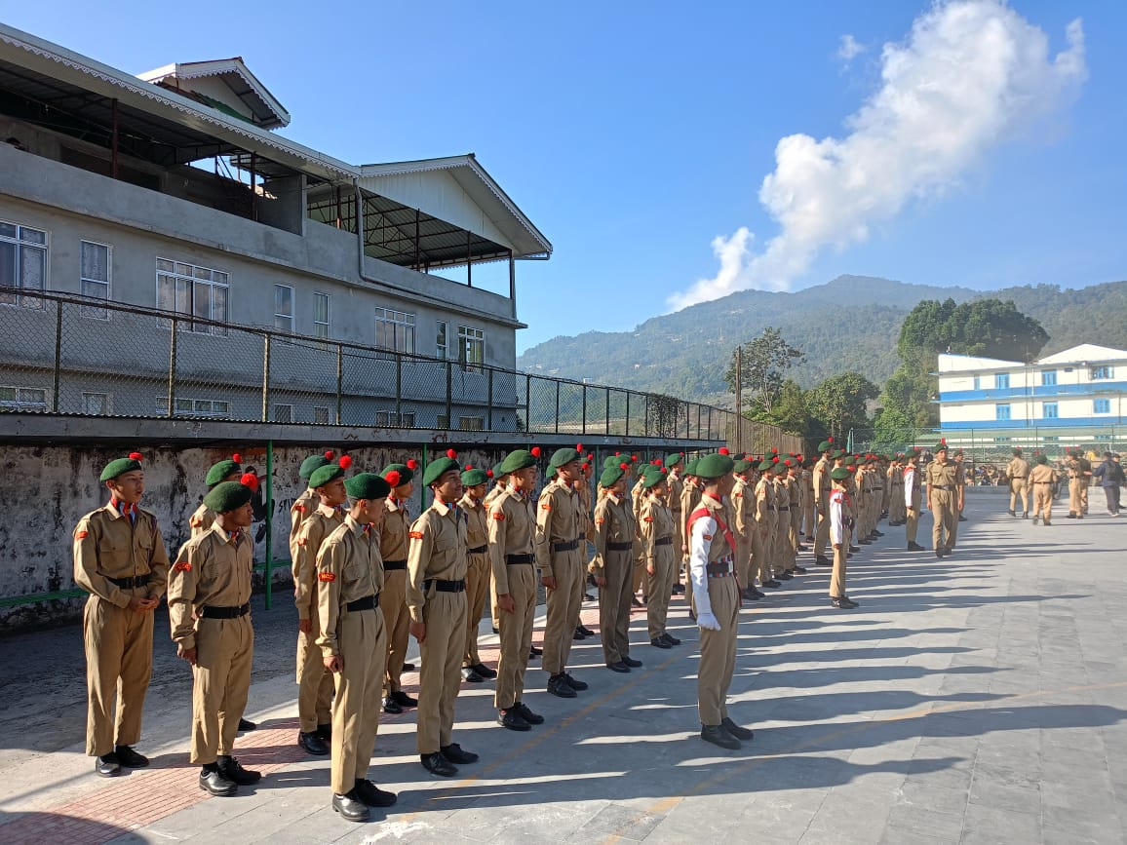
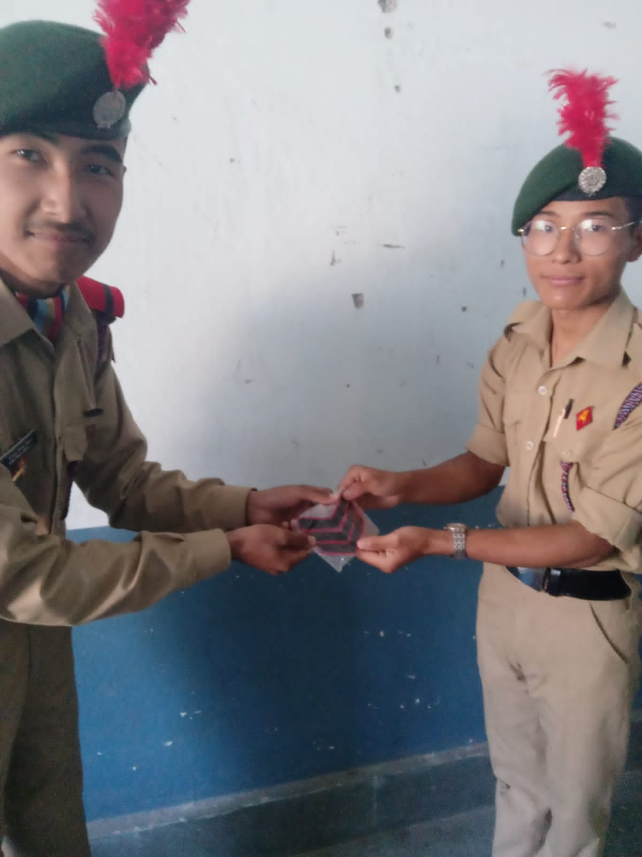
NCC conducts camp every year. So far the students have attended 3 CATC 1 ATC on 22nd- 24th Nov 2022. The first camp was conducted at Rhenock College for ten days. The second and third camp was conducted at St Xaviers’s School; Pakyong from 10th Dec to 19th Dec 2023 and from 3rd Jan to 12th Jan 2024. Similarly the venue for another camp was at Kamrang University from 25th Feb to 5th March 2024. During the camping Sang Sen. Sec School won many accolades in competitions. The students were awareded with medals and certificates.
Master Karma Chopel Lepcha from Sang School has been promoted to Senior Sergeant Rank from 3rd Sikkim Battalion Unit NCC.

Slide 32
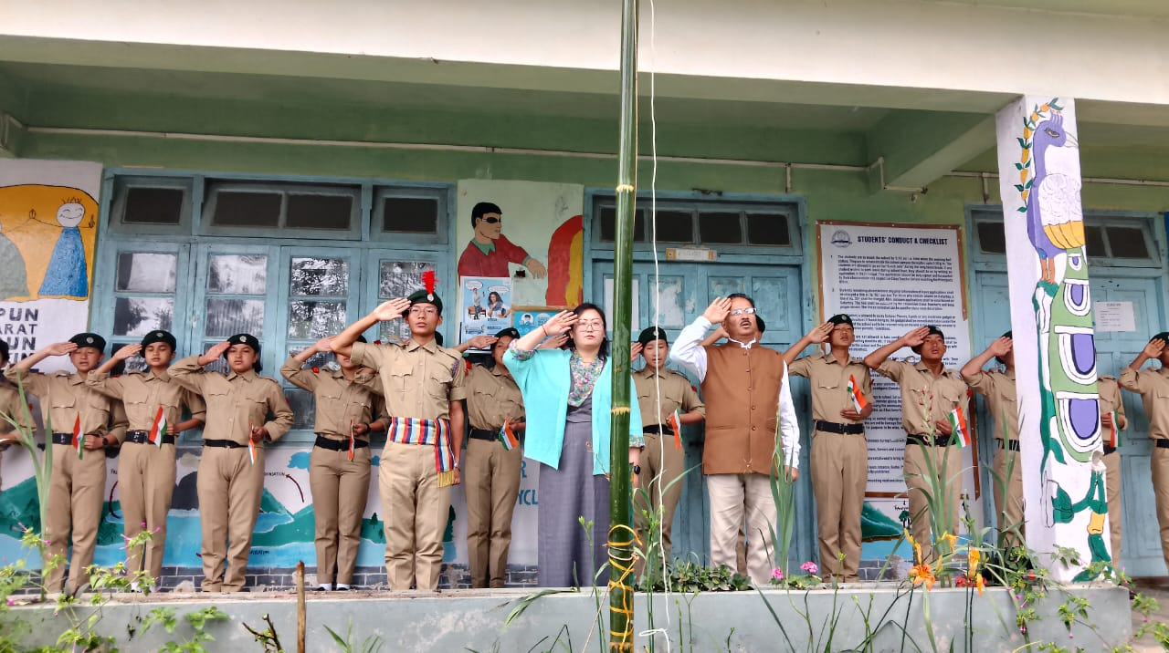

Slide 33
NSS (National Service Scheme)
Mr. HemantChettri
Mr. Dinesh Rai
NSS Programme Officer
The National Service Scheme (NSS) is an Indian government- sponsored public service program conducted by the Department of Youth affairs and Sports of the Government of India. To inculcate social welfare and community service in student various activities and programmes were conducted under the banner of NSS.
The NSS unit of Sang SSS organizes regular activities in organizing blood donation camp, plantation drive, Swachchha Bharat Abhiyaan (cleanliness drive and field visits), health awareness, international peace day, Ekta Diwas celebrations, National Education Day, consumer awareness programme, international yoga day, rally on road safety, Green Walk, Rallies, Marathon, speech, debate, painting, essay competition and slogan writing.

Slide 34
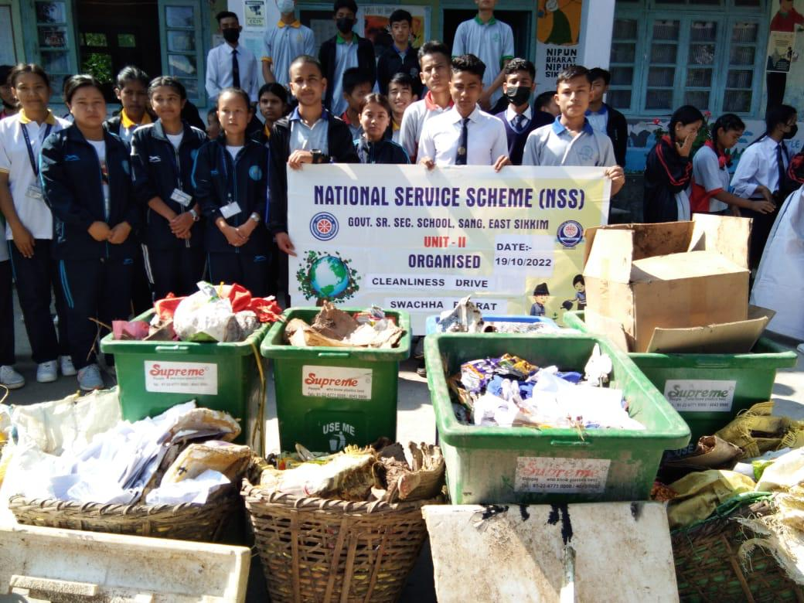
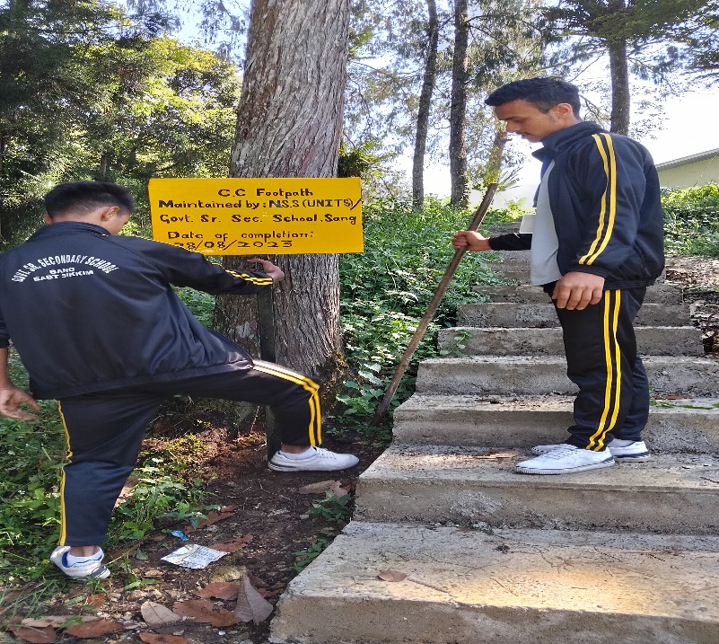
Swachh Bharat, Ekta Diwas Celebration, national education day, consumer awareness programme, international yoga day, rally on road safety and drugs, voters awareness programme, street play against addiction, blood donation.

Slide 35
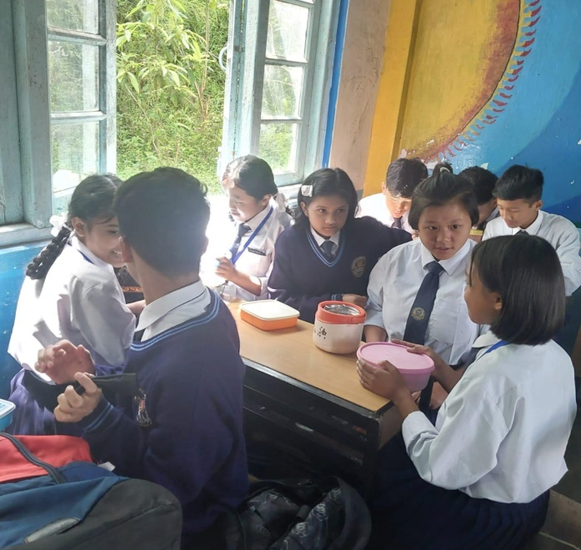
ANNUAL ACTIVITIES OF ECO-CLUB: A REPORT
Mr. sonam Tashi Bhutia
GTA
ECO Club Co-ordinator
Sang School has initiated a small step to create and develop awareness and a sense of ecological environment among the students through curricular and co-curricular activities. The Eco Club team has strictly undertaken the campaign of NO JUNK FOOD and BAN OF POLYBAGS IN SCHOOL. The students clean the surrounding areas by picking the waste and plastic materials. Each members of the club motivate each other to imbibe habits and lifestyle for minimum waste generation, separation of waste and disposing the waste to the nearest storage point. To keep the surroundings clean and green the students with the help of teachers participate in plantation drive. More than 200 saplings are planted in an around the school campus every year. They are also taught to promote conservation of water by minimizing the use of water.

Slide 36
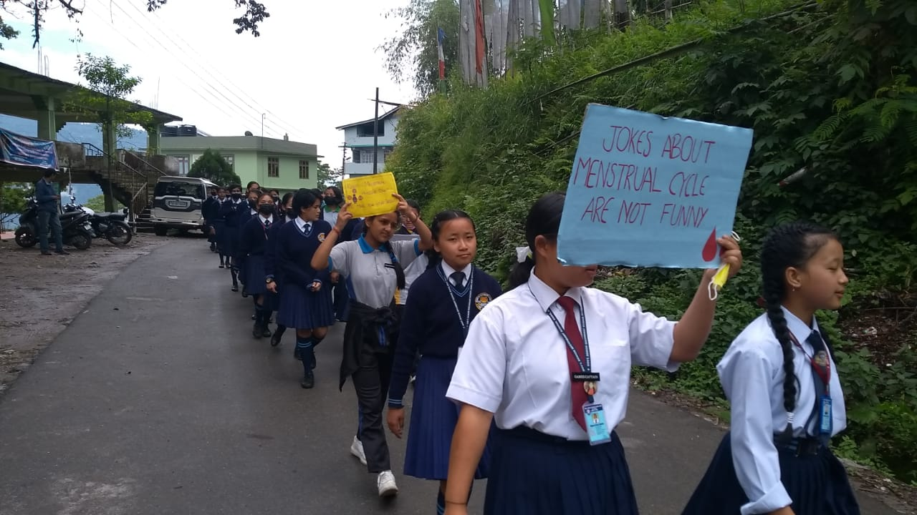
The students are educated to create awareness amongst public and sanitary workers so as to stop the burning of waste that causes respiratory diseases. The activities undertaken by Eco Club members of Sang School are in rallies and awareness spreading campaigns, cleanliness and beautification of school, special assemblies to celebrate Earth Day and Environment Day, programmes like Quiz and Poster making Painting Competitions on Environment, Display boards in classrooms, educational trips, rain water harvesting and herbal garden.

Slide 37
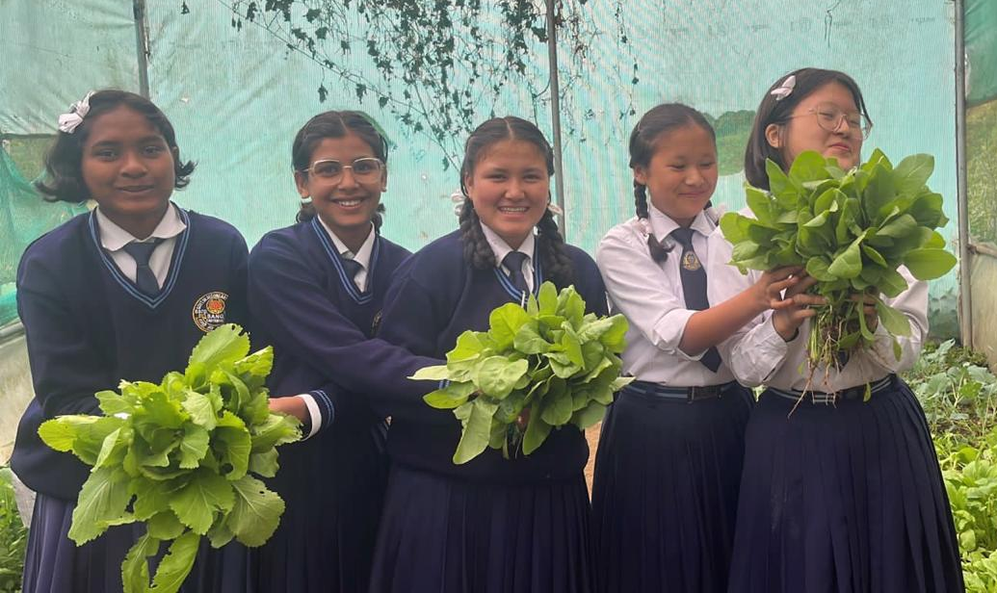
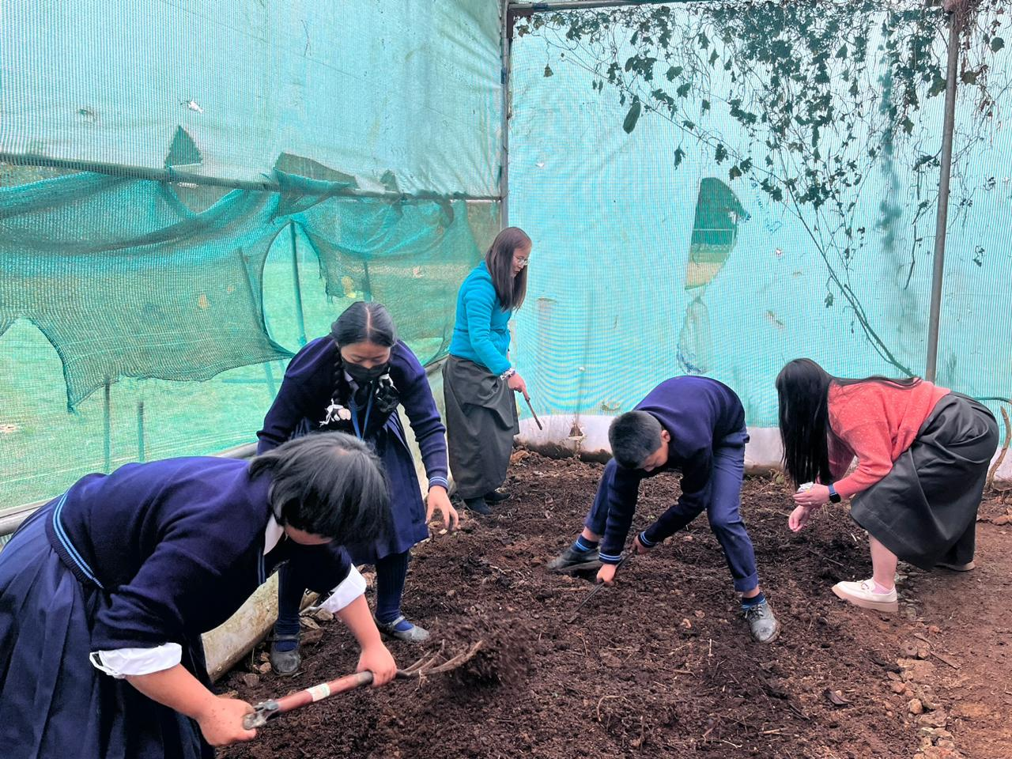
Organic farming by Chumpi Tshering Bhutia PGT ( VOC )
The state ‘s school education department has introduces organic faring in school. The objective of this farming in school is to create awareness to students on the importance of organic farming, Healthy food habits, Harmful effect of chemical based to health and regain importance of saving environment. Teachers are assigned to guide and access the performance periodically in implementing the program as life skill activity without the use of pesticides . Organic vegetables grown in school are used in the Mid Day Meal or Distributed among students and Teacher consumption. The students and teacher mentors have grown winter vegetables Raddish, Coriander, Garlic, Brinjal, Chillies, Carrot Potatoes cauliflower , Broccoli. Summer vegetables such as Lady Finger, Bitter Guard, Bottle Guard. etc

Slide 38
HERBAL GARDEN

Slide 39
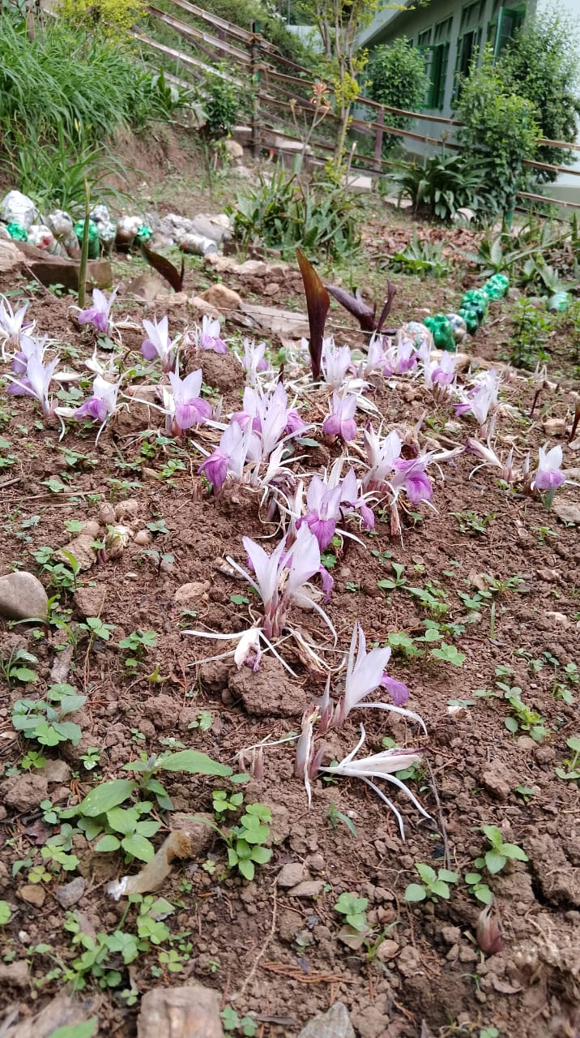
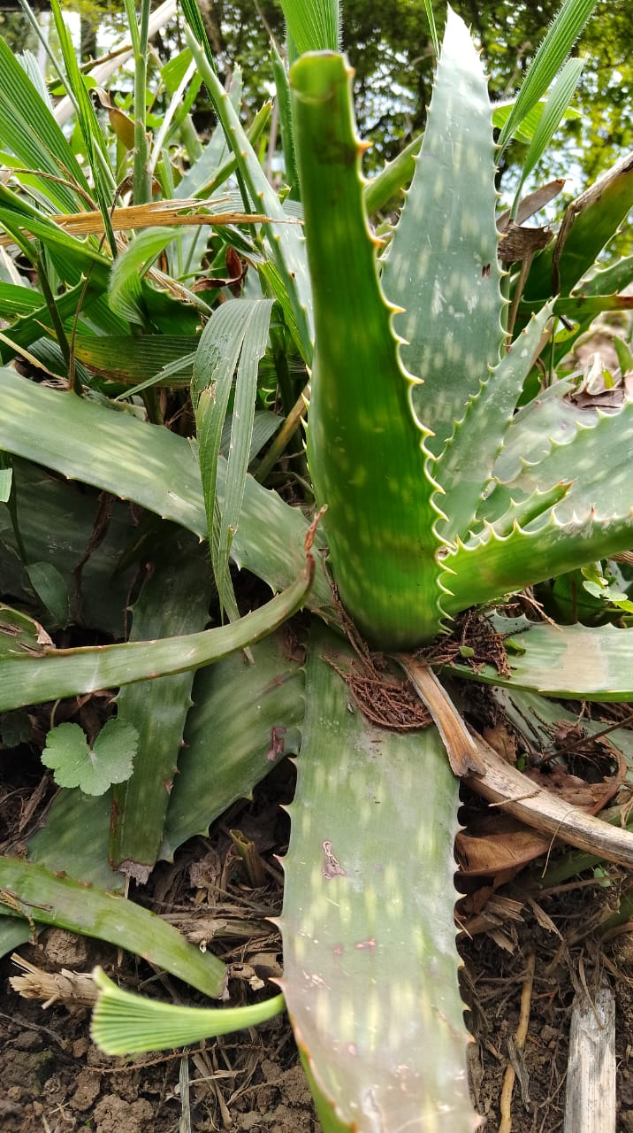

Slide 40
My Dad
Sneha lohagun
Class XII ( SC )
You are a beautiful masterpiece
That God created you with ease
How deep my love for you is
Thank God he who fulfilled my wish!
That sweet perfect smile
Makes my heart run a mile
He who is greater than God
I call him my ‘DAD’
Your voice makes me strong
You taught me what’s right or wrong.
I feel safe when you are with me
Your smile says it all.
Dad! I love you more than all.

Slide 41
My Mother
Suchenla Tamang
XII ( SC )
Mother is the most precious person that cannot be described in words. Mother is a real blessing of God. The only unconditional love in the world is a mother’s love. Not only had she given birth to me but she has sacrificed her whole life for the well being of her child. My mother’s name is Nima Lakhi Tamang and she is the most important person in my life. She works as an anganwadi helper. She is very kind and hardworking. She wakes up early in the morning and cooks food for all of us. She is very humble and whenever I am in problem she always helps me tackle it. Whenever I fall sick she takes care of me. I love my mother very much. For me she is a superwoman who helps me in every situation of my life. I am very grateful to have her in my life.

Slide 42
MY BESTFRIEND Nikita Bhujel XII ( com )
You are the best person that I got in my life and I am always grateful to have you in my life. We have been together since childhood and have never been apart. Though we are miles apart but my love and care towards you will not be less. No matter how many people have tried to break our friendship but remember that I will always be there for you. Most of the people aren’t lucky enough to have such a strong friendship in their life. But I know how lucky I am to have you as my best friend.

Slide 43
Life of Eleventh
Tshering Ongmu Bhutia
XII ( HUM )
The life of the “Eleventh”
After that of the horrible ‘Tenth’
Which dawned out of the blue
Seems hardly to be true.
Periods spent with less study
With no tension and friend at ease
Days spent in leisure
And peaceful nights we shall treasure.
Eating in class with great secrecy
Chuckling in deep privacy
Jokes and games and fun and frolic
Send the class into roars of laughter.
Songs sung by amateur singers
Drumming the desk with slim fingers.
Reading works of favourite authors
And day dreaming in class without bothering others
Listening to useless gossips
With protruding lips
No matter what the game
Having fun together all the same.

Slide 44
women WOMEN
Dawden Lepcha
XII ( HUM )
As a woman
I am strong
I have a purpose
There is strength in the way that I think
There is a purpose for my speech
I feel the power of my voice holds
I feel the power within my folds
Our perspectives will change how you see
As a women we are powerful beings.

Slide 45
MEMORIES – AN ODE TO FRIENDSHIP
Nirjala Rai
XII ( SC )
A friend is like a star that twinkles and glows
To care for a friend is what I like to do
Make them happy and laugh till we are blue
A friend is like a gold that you should treasure
And take care of forever and ever
Through thick and thin, up and down
Your true friends are always around
They will always be there to hold you tight
Anytime, no matter if its day or night
The two of us –a perfect blend
My dear and treasured friend.

Slide 46
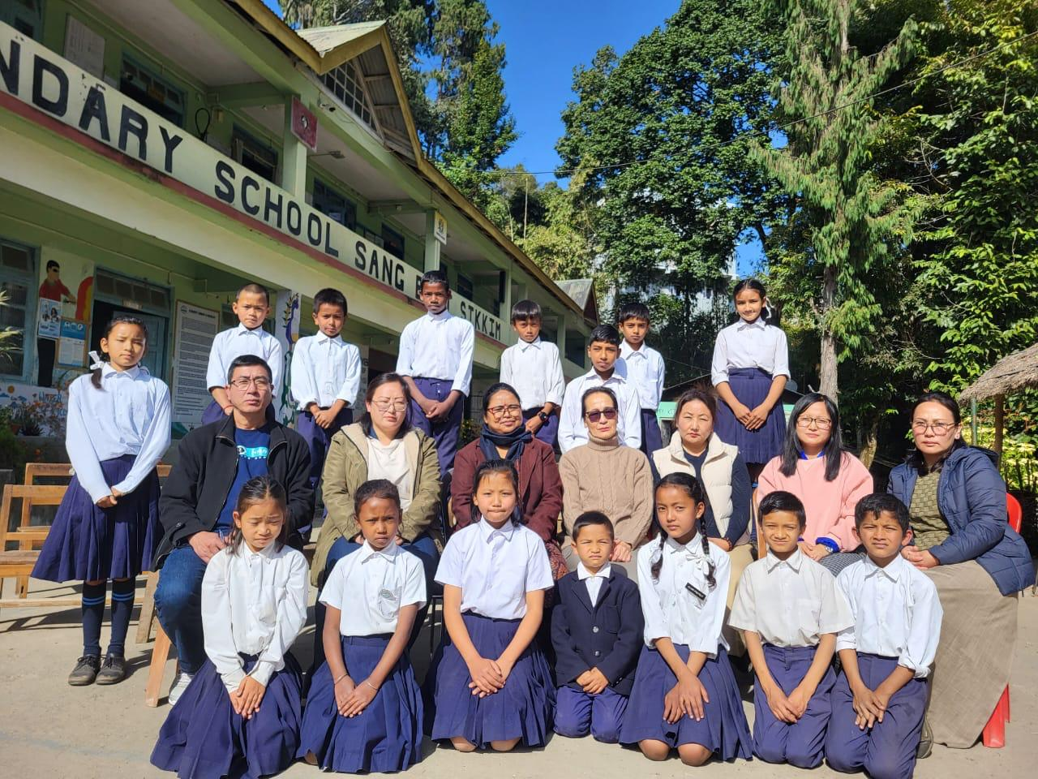
PRIMARY SECTION-2023

Slide 47
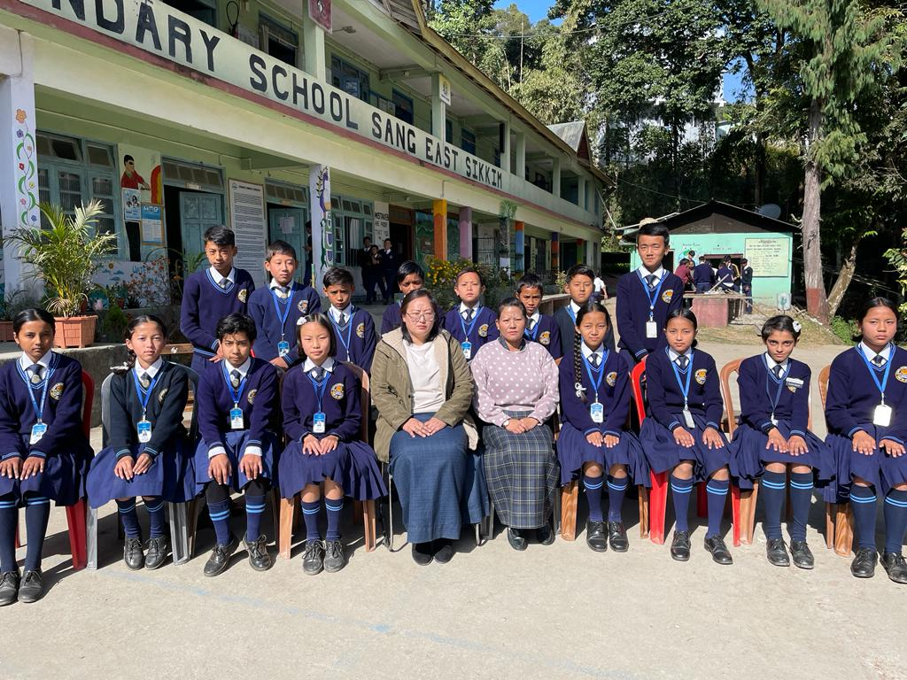
CLASS - VI

Slide 48
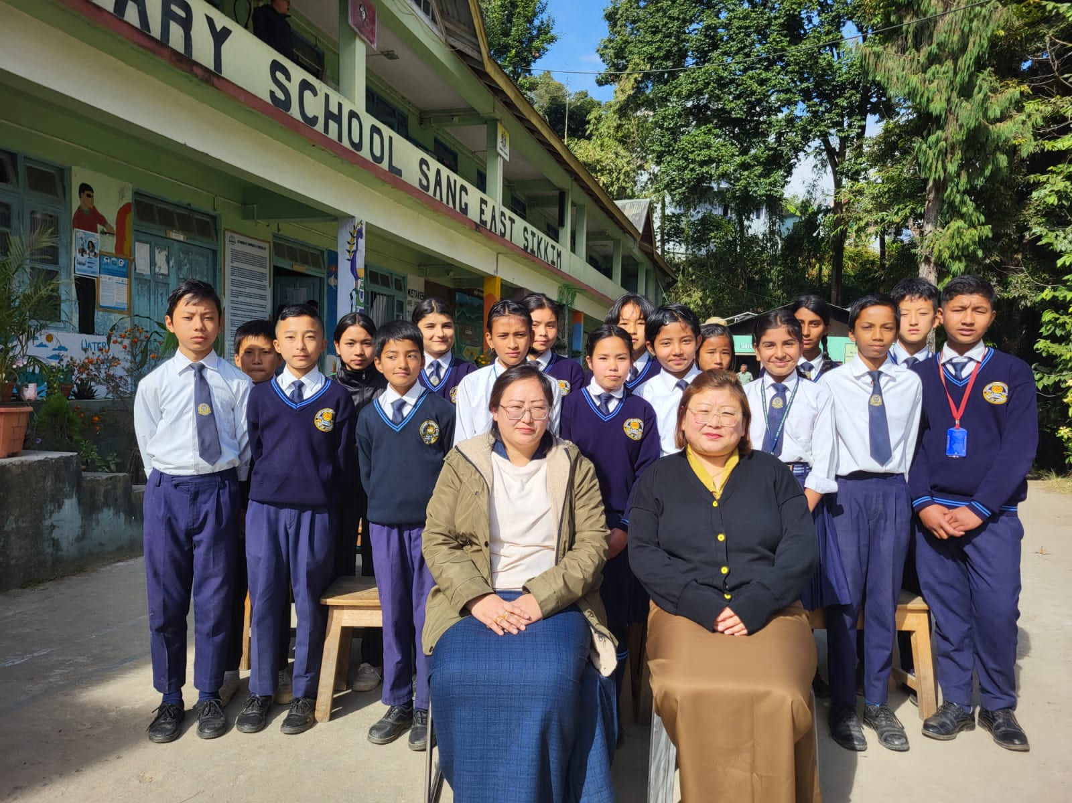
CLASS VII

Slide 49
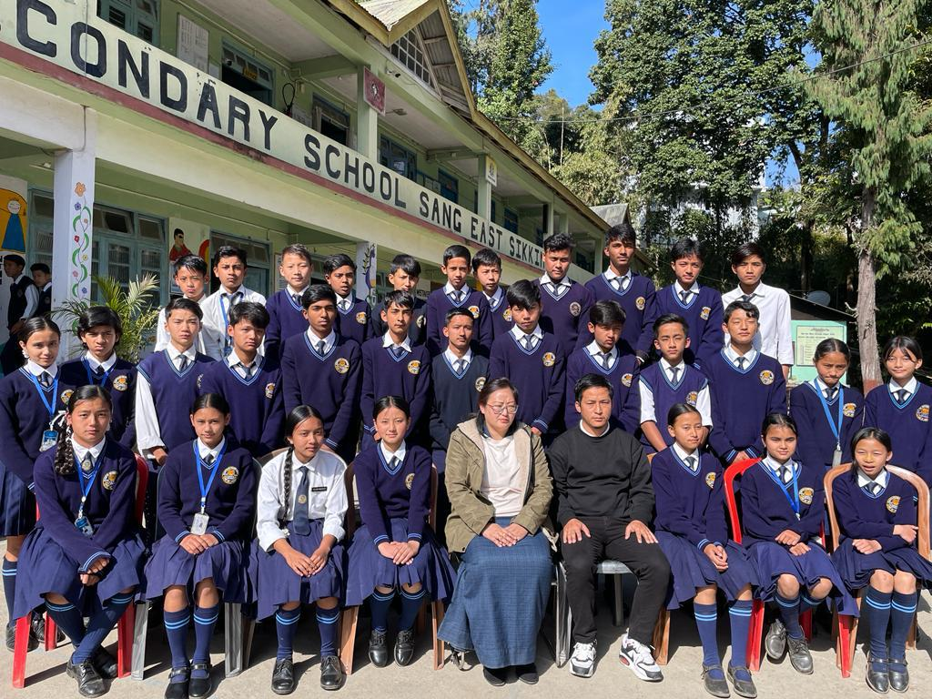
CLASS VIII

Slide 50
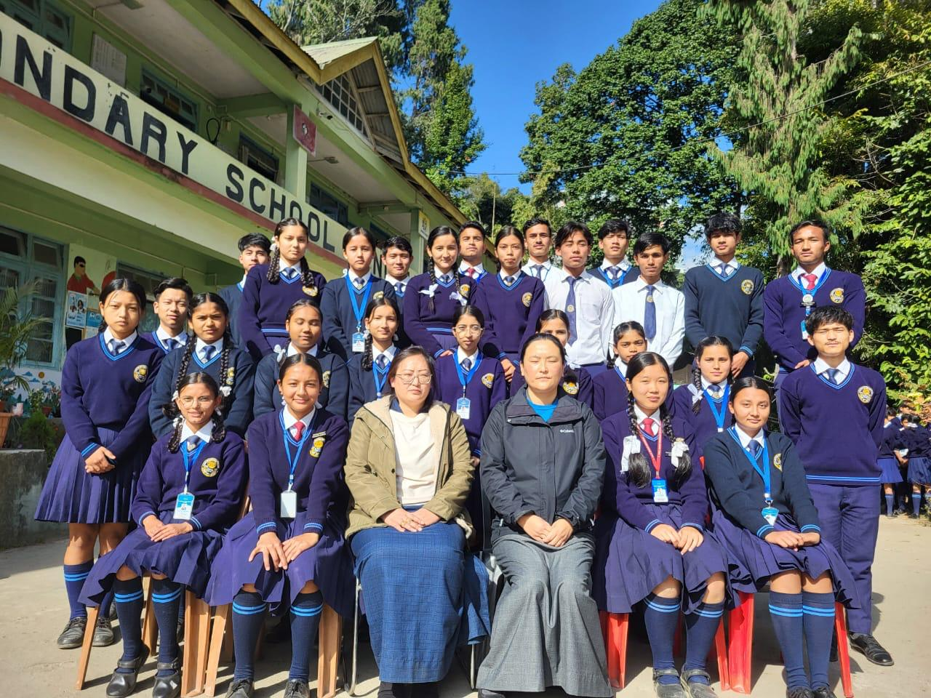
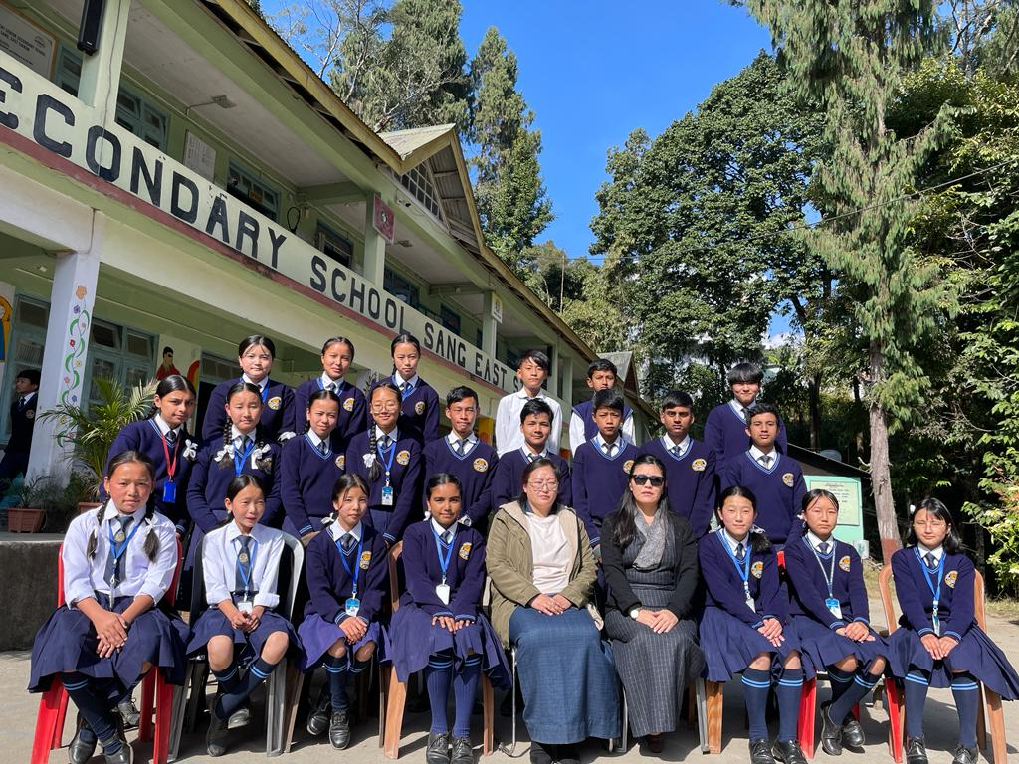
CLASS IX ( A)

Slide 51
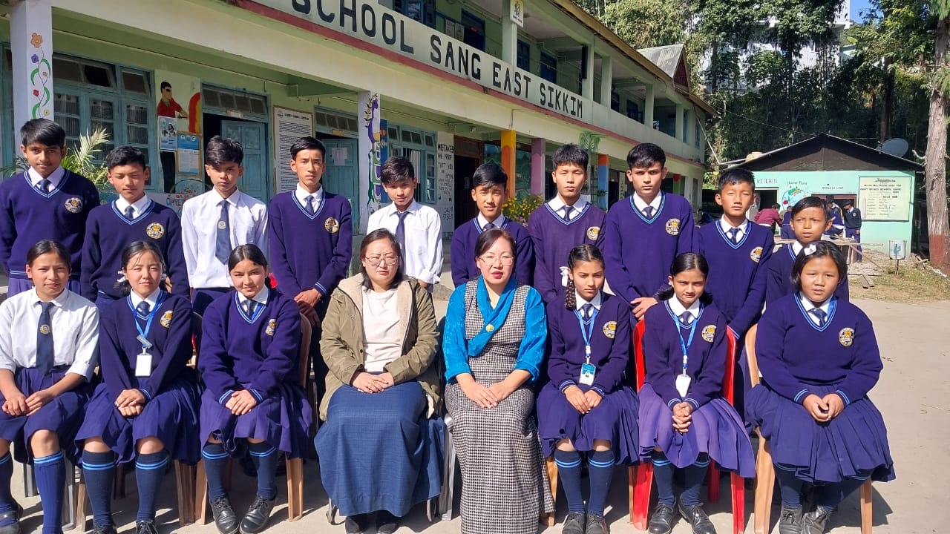
CLASS IX ( B )

Slide 52
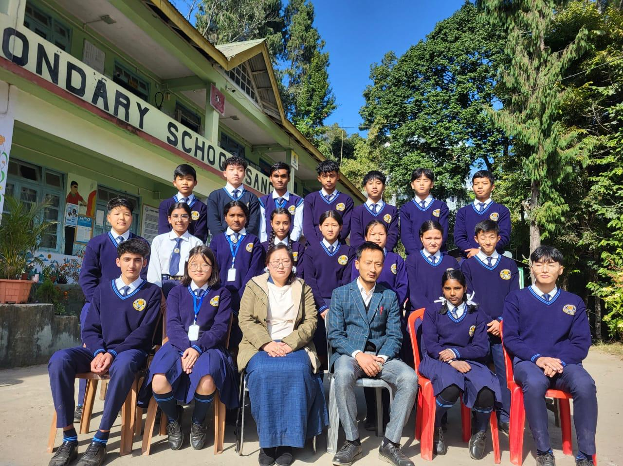
CLASS – X

Slide 53
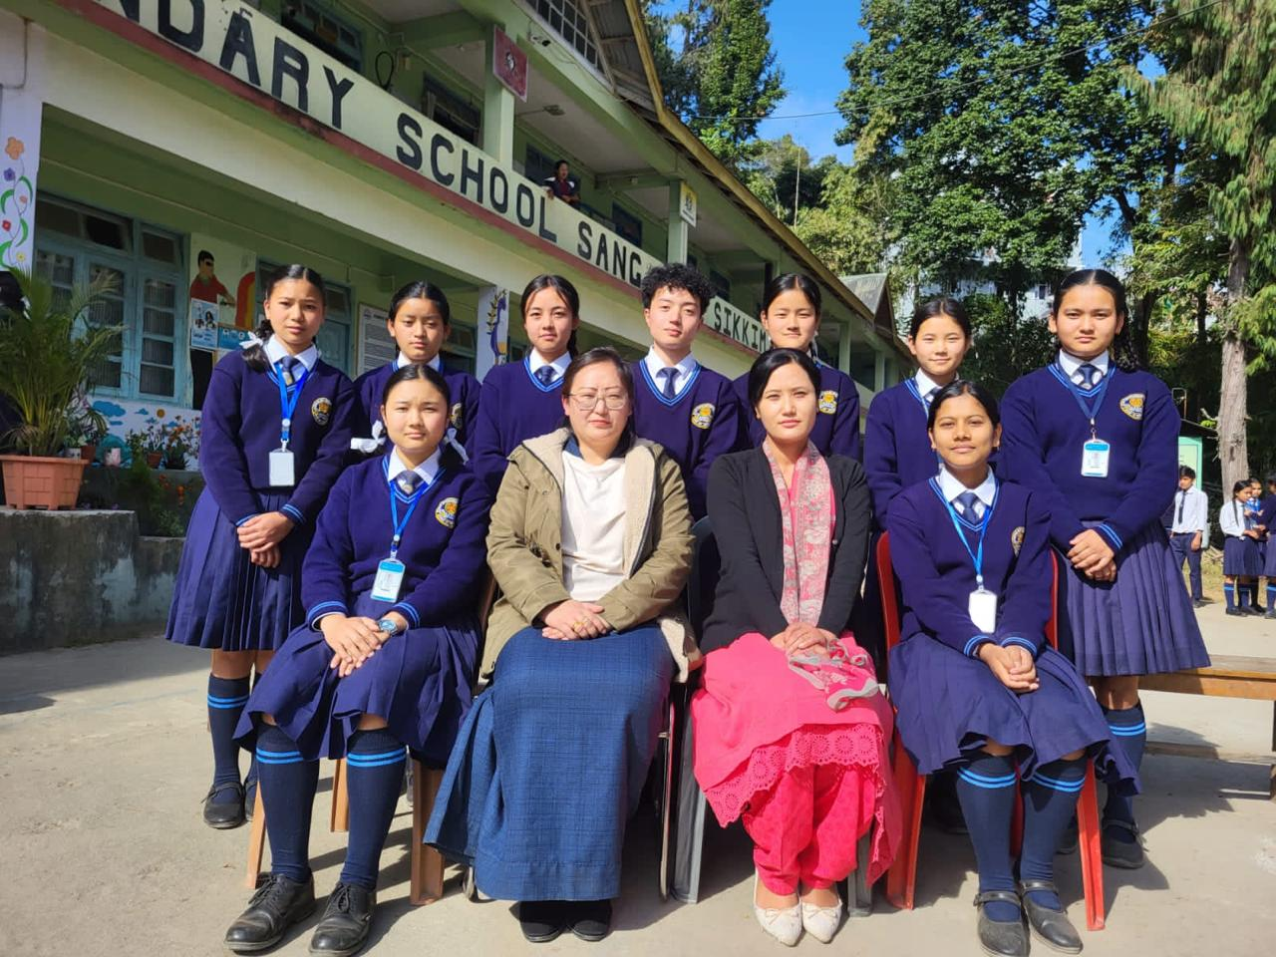
CLASS XI ( SC)

Slide 54
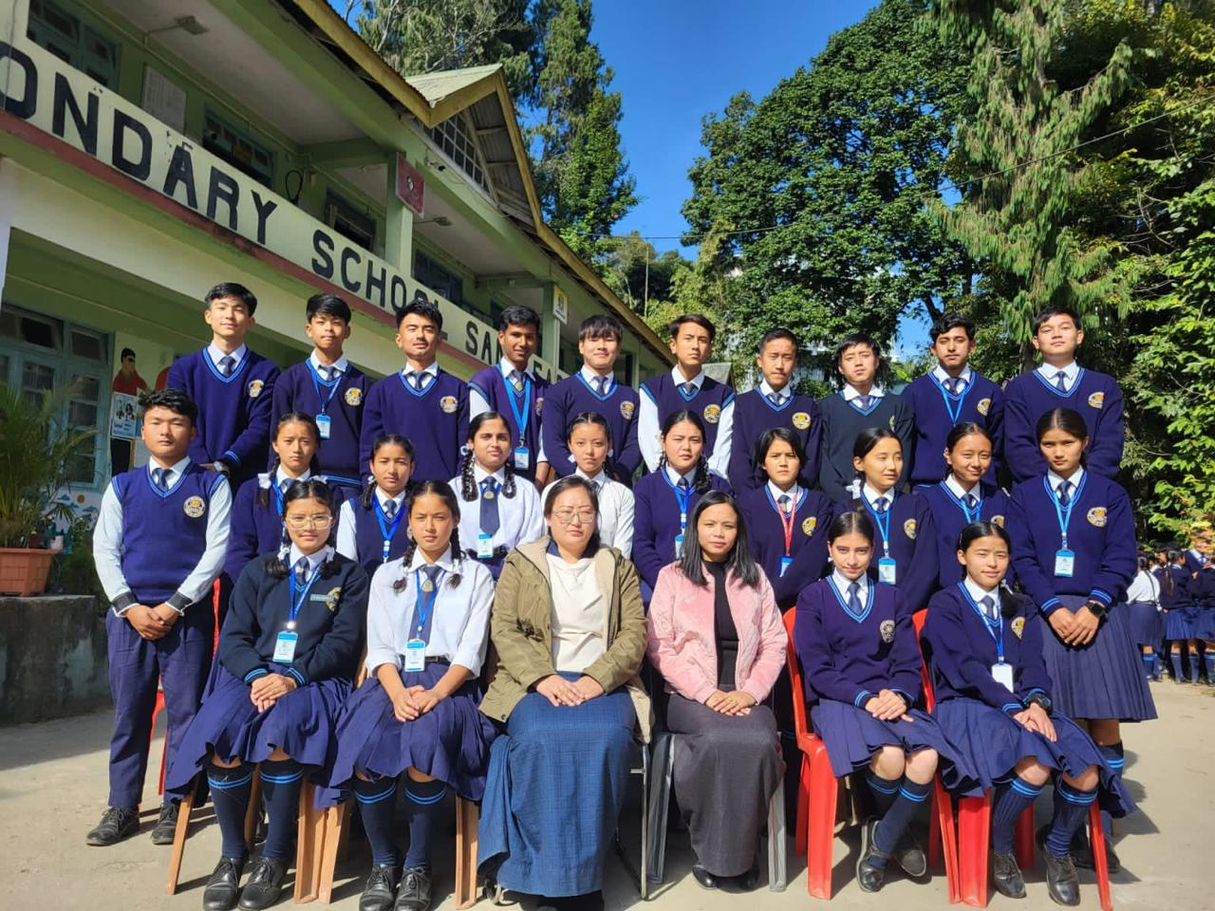
CLASS XI ( Arts )

Slide 55
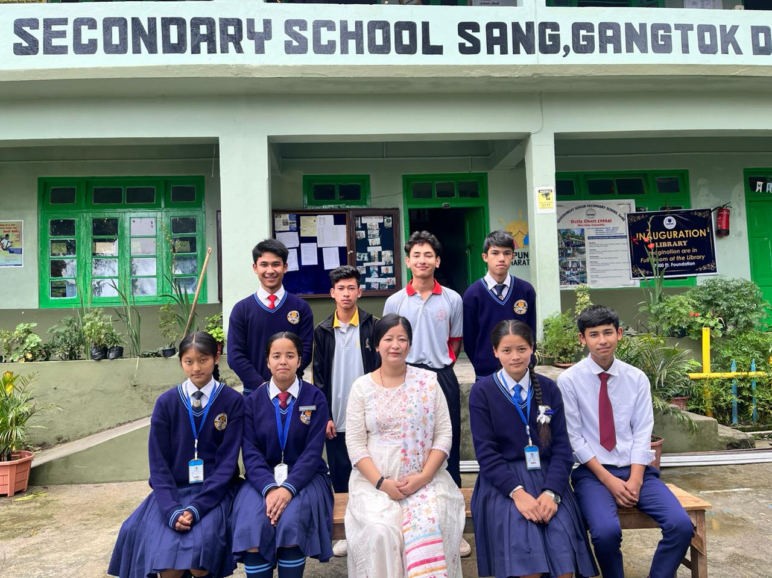
CLASS XI ( Commerce )

Slide 56
CLASS – XI ( TT )

Slide 57
CLASS XI ( FP )

Slide 58
CLASS XII ( Humanities )

Slide 59
CLASS XII ( TTM )

Slide 60
CLASS XII ( Commerce )

Slide 61
CLASS XII ( Science )

Slide 62
FAREWELL

Slide 65
GAMES AND SPORTS

